Slide 1
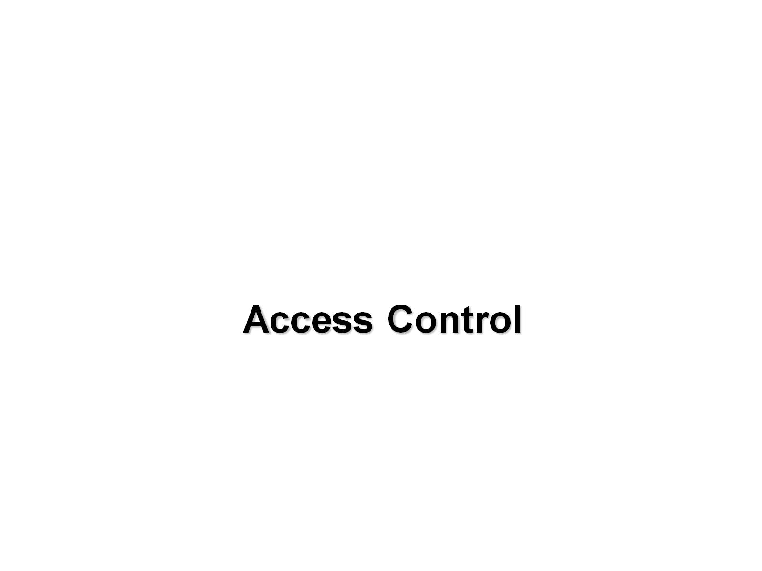

Slide 2
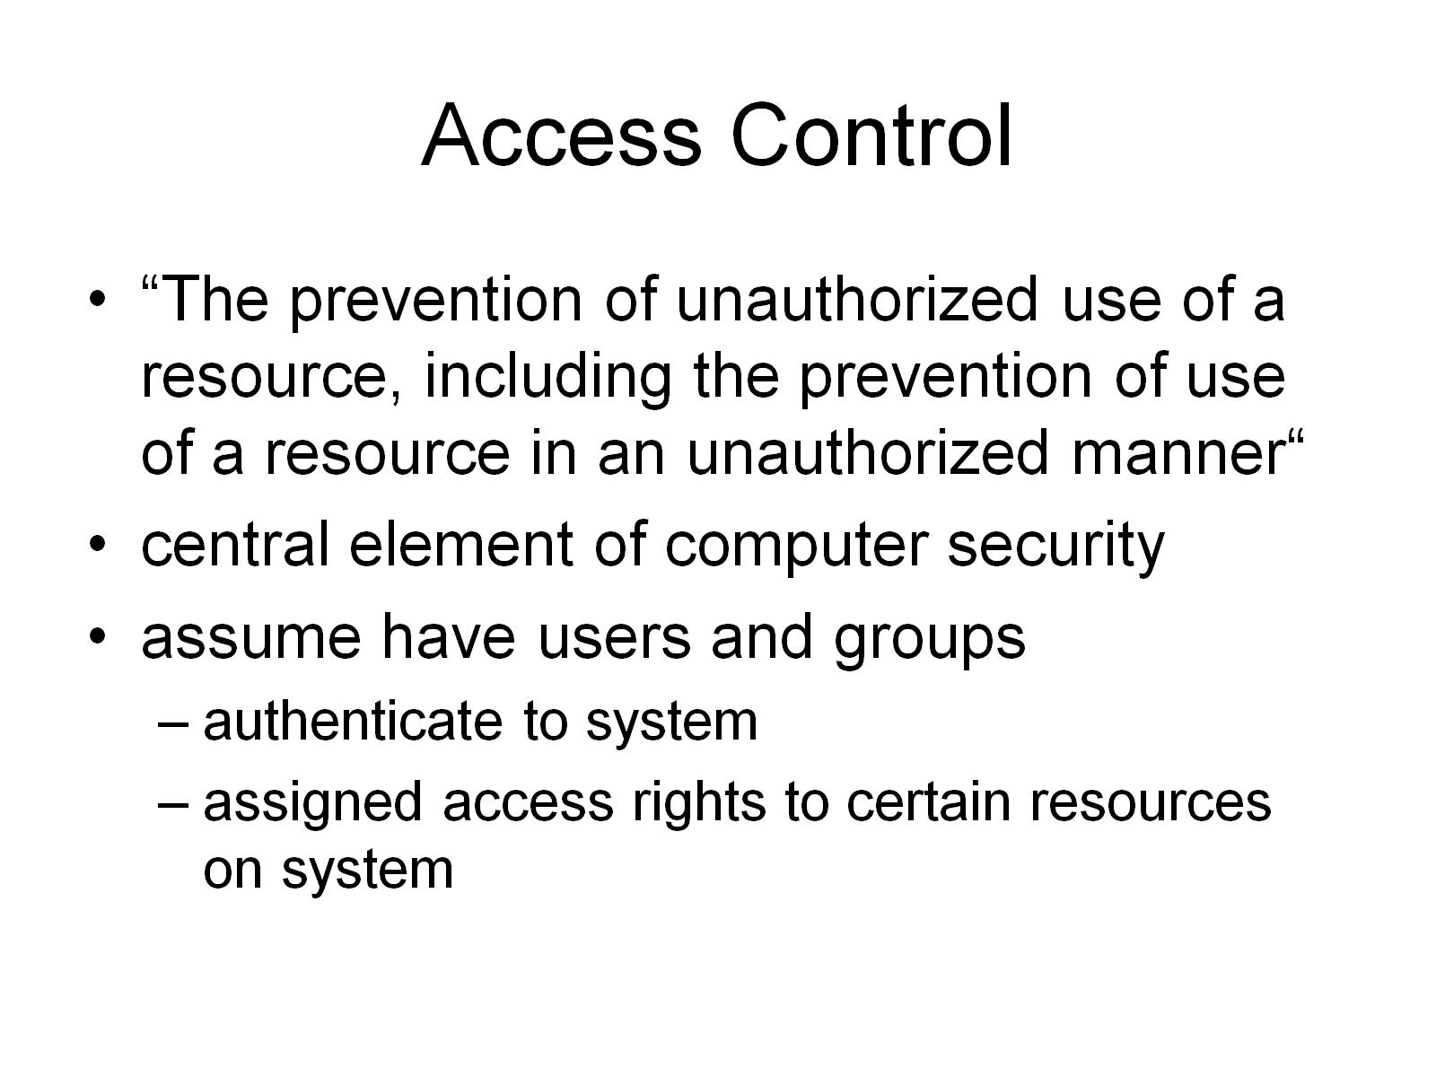
Access Control

Slide 3
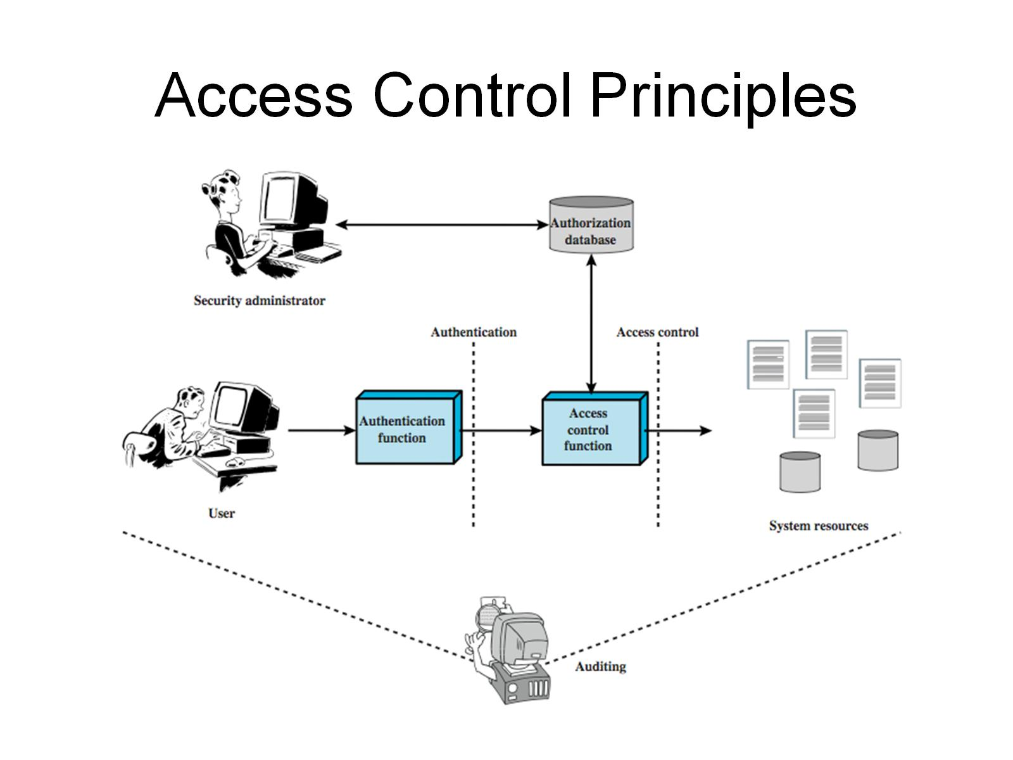
Access Control Principles

Slide 4
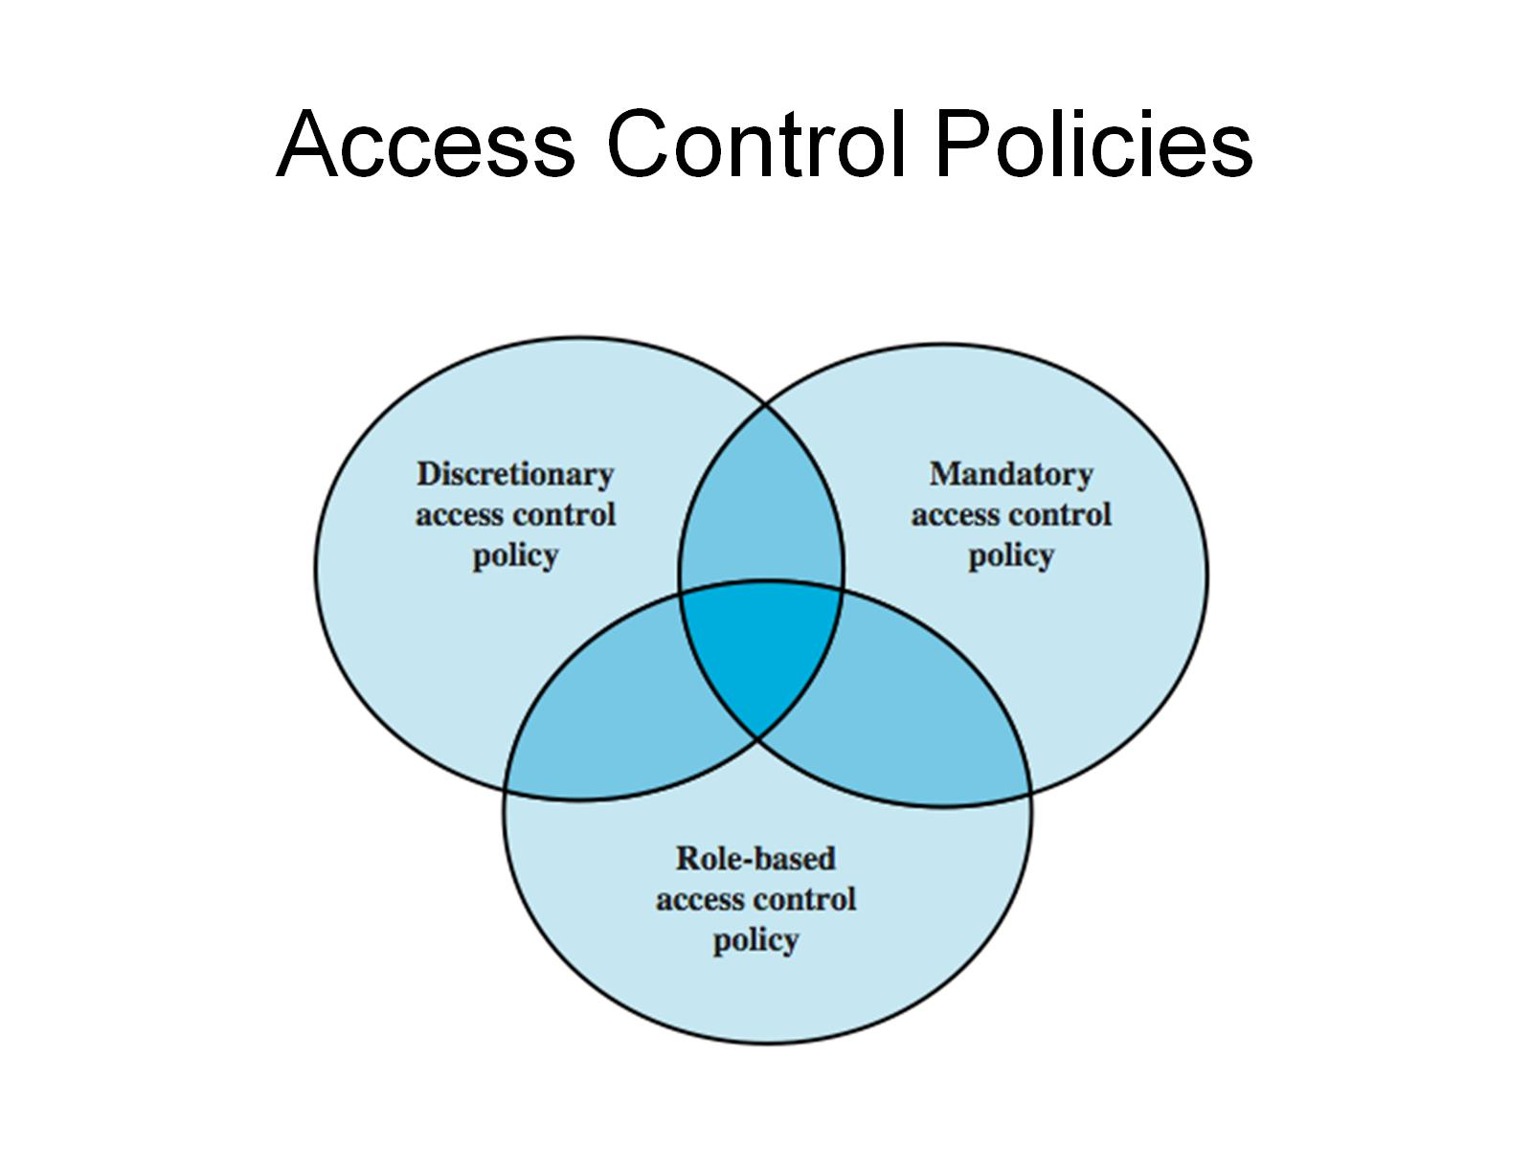
Access Control Policies

Slide 5
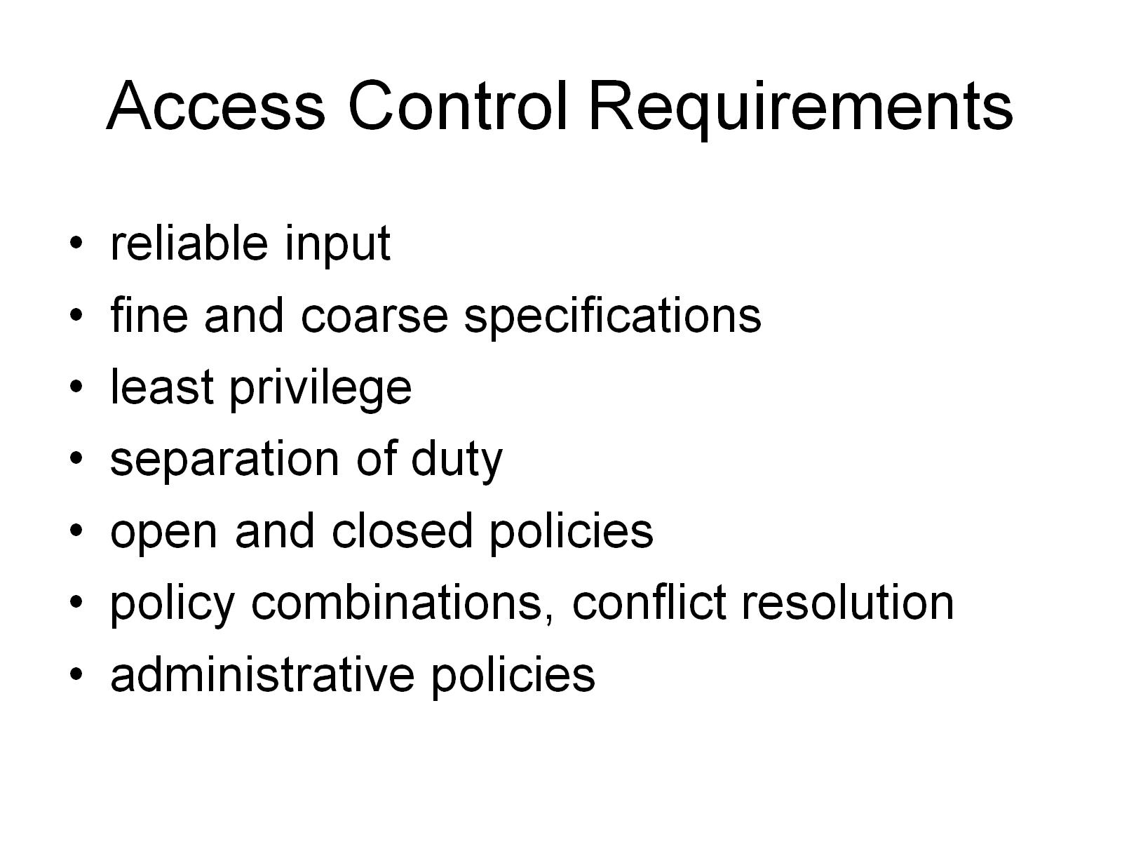
Access Control Requirements

Slide 6
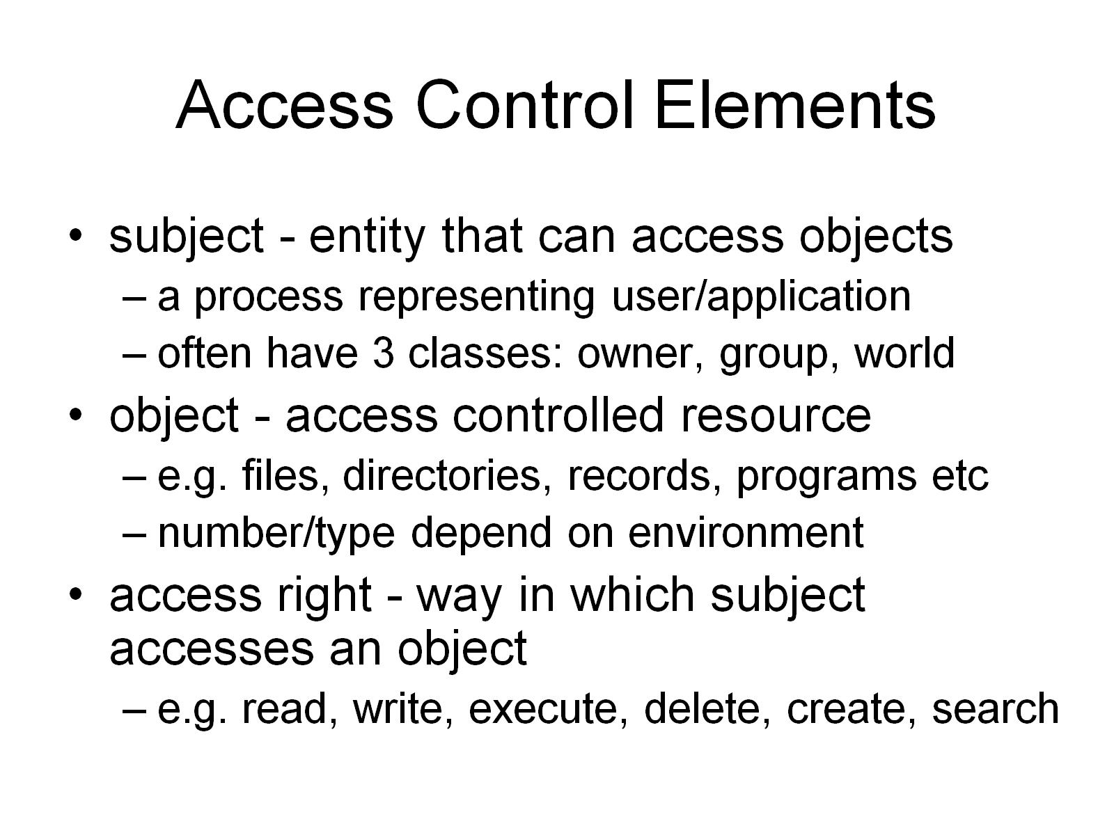
Access Control Elements

Slide 7
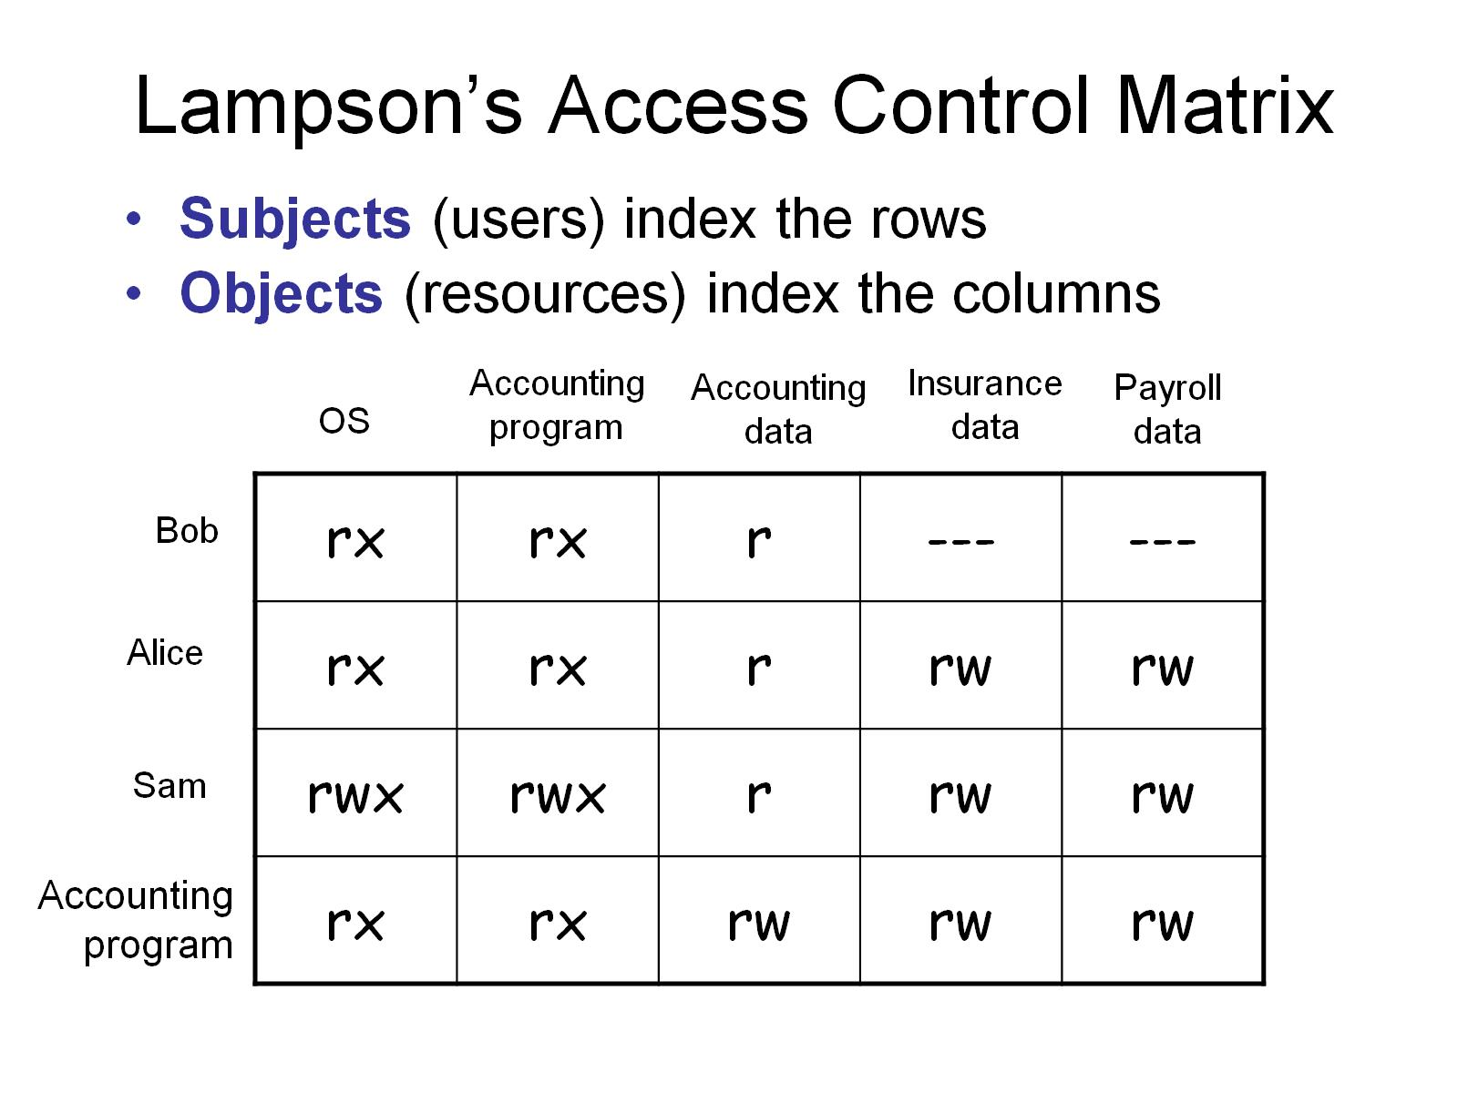
Lampson’s Access Control Matrix

Slide 8
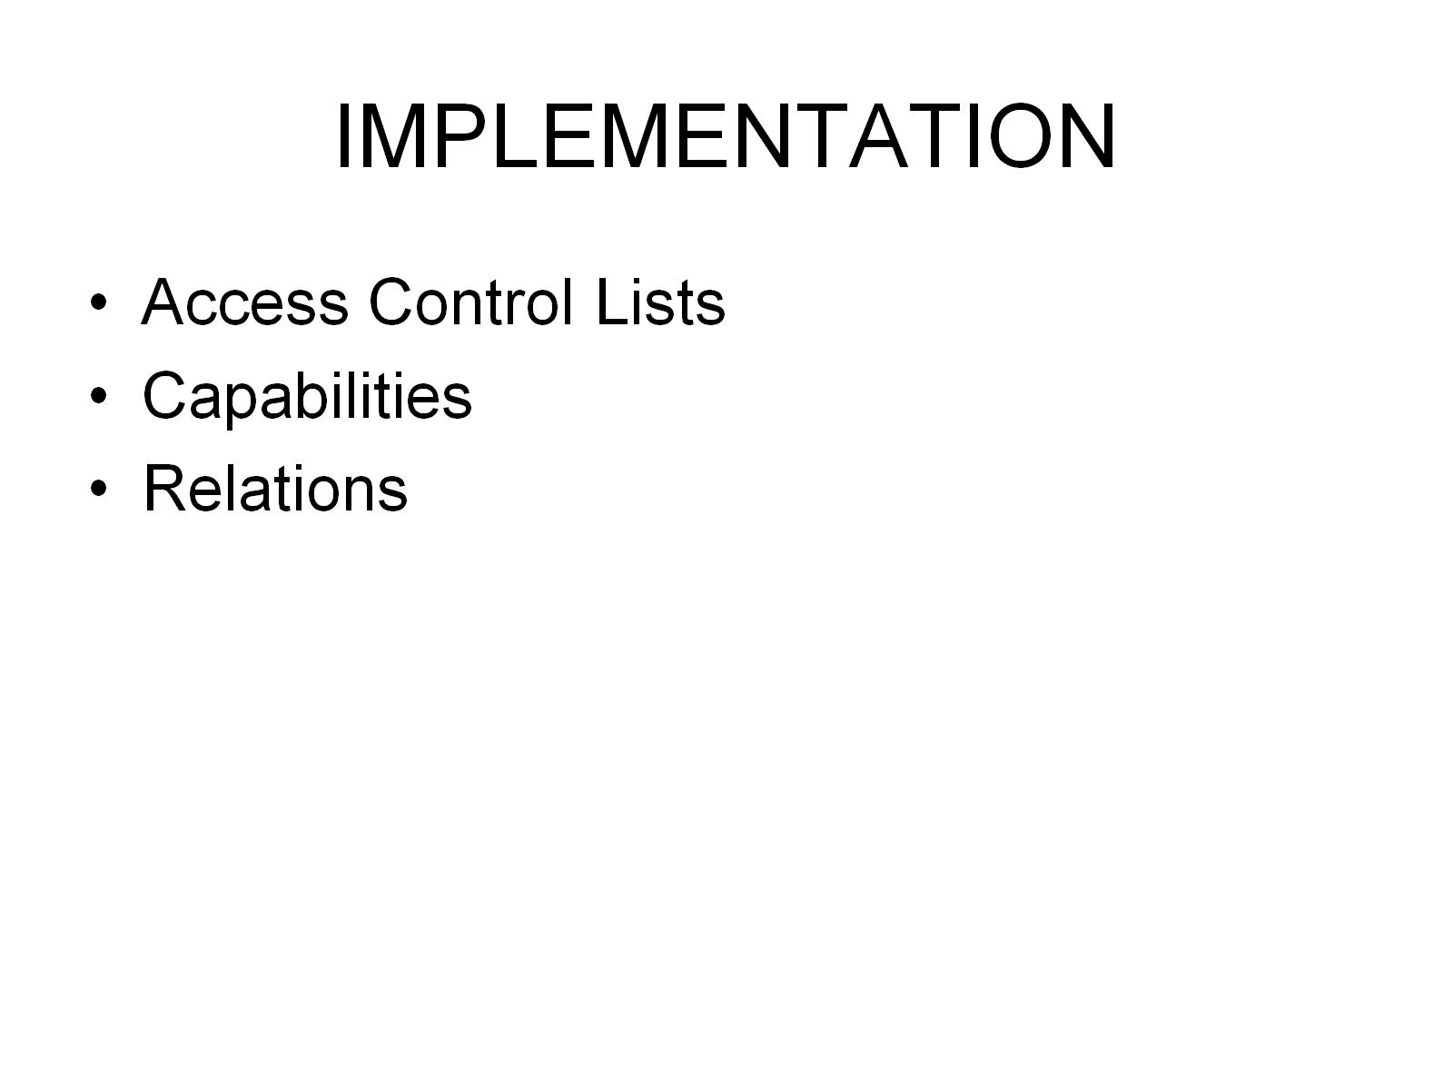
IMPLEMENTATION

Slide 9
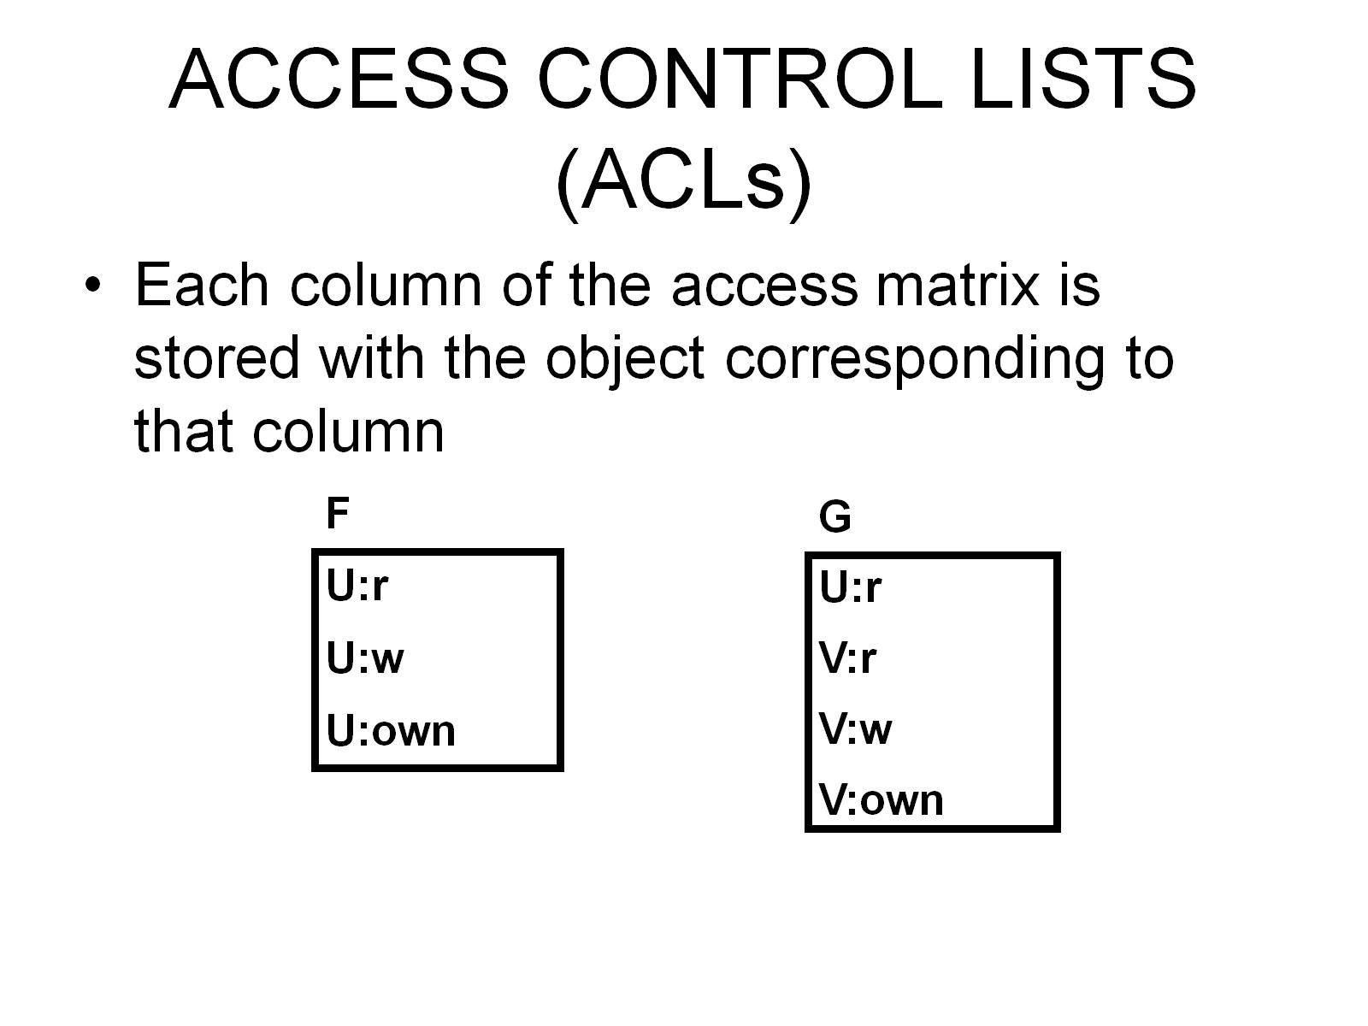
ACCESS CONTROL LISTS (ACLs)

Slide 10
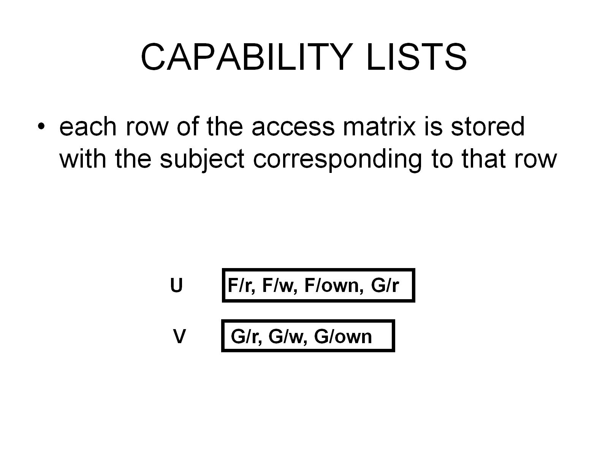
CAPABILITY LISTS

Slide 11
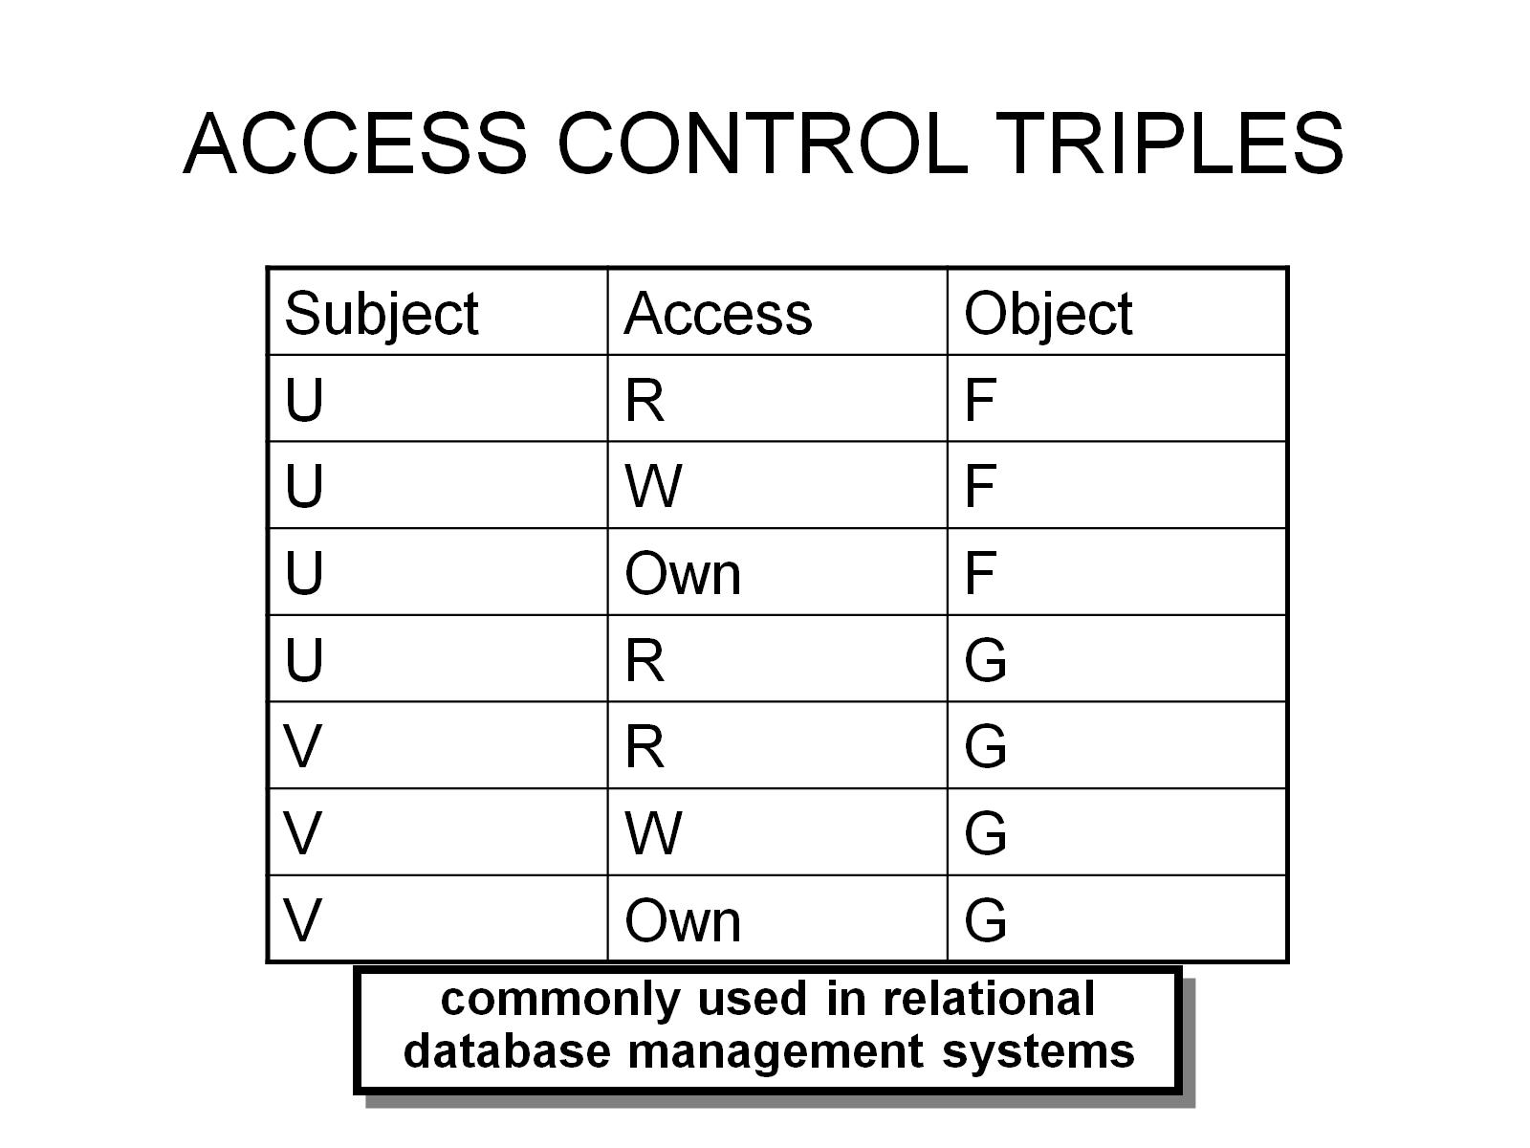
ACCESS CONTROL TRIPLES

Slide 12
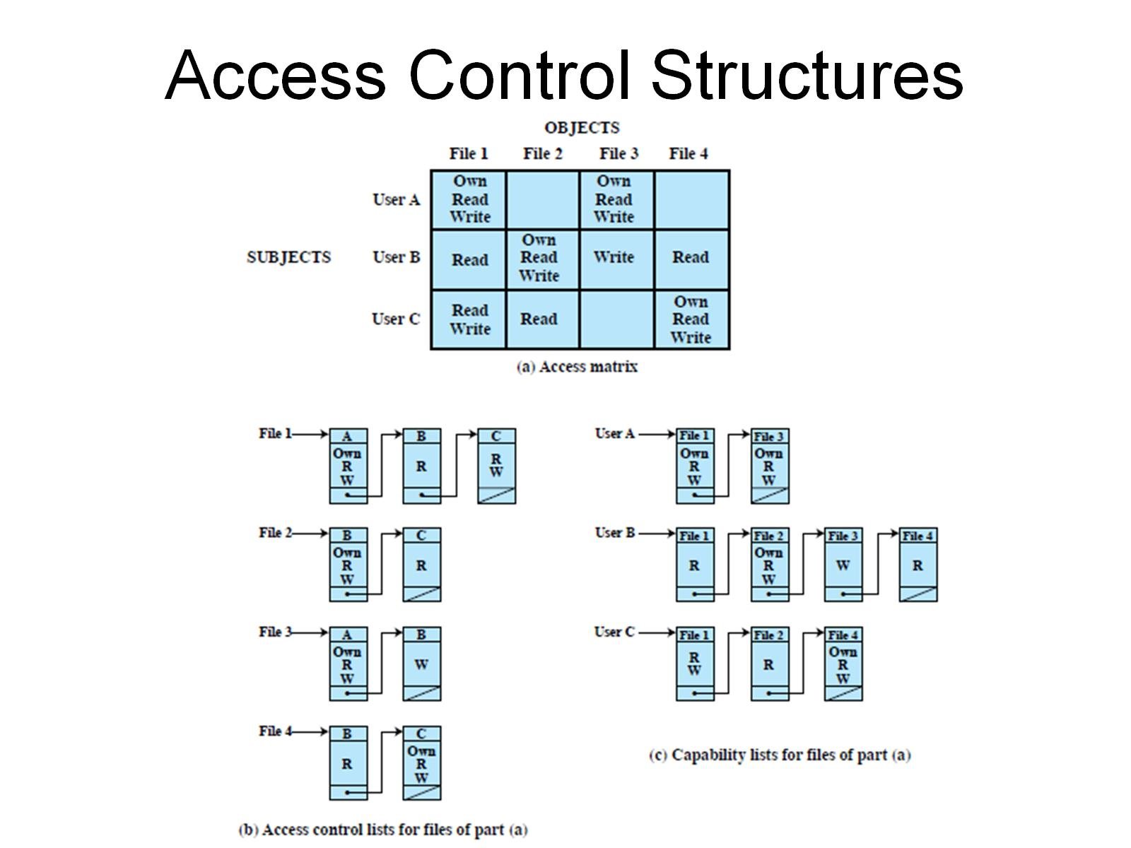
Access Control Structures

Slide 13
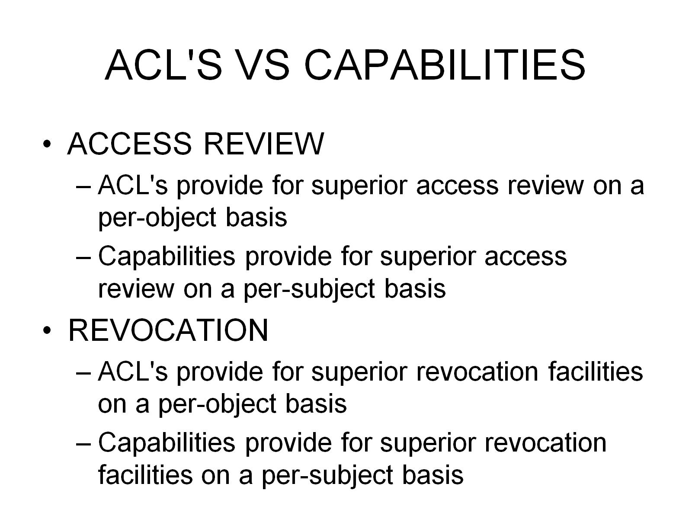
ACL'S VS CAPABILITIES

Slide 14
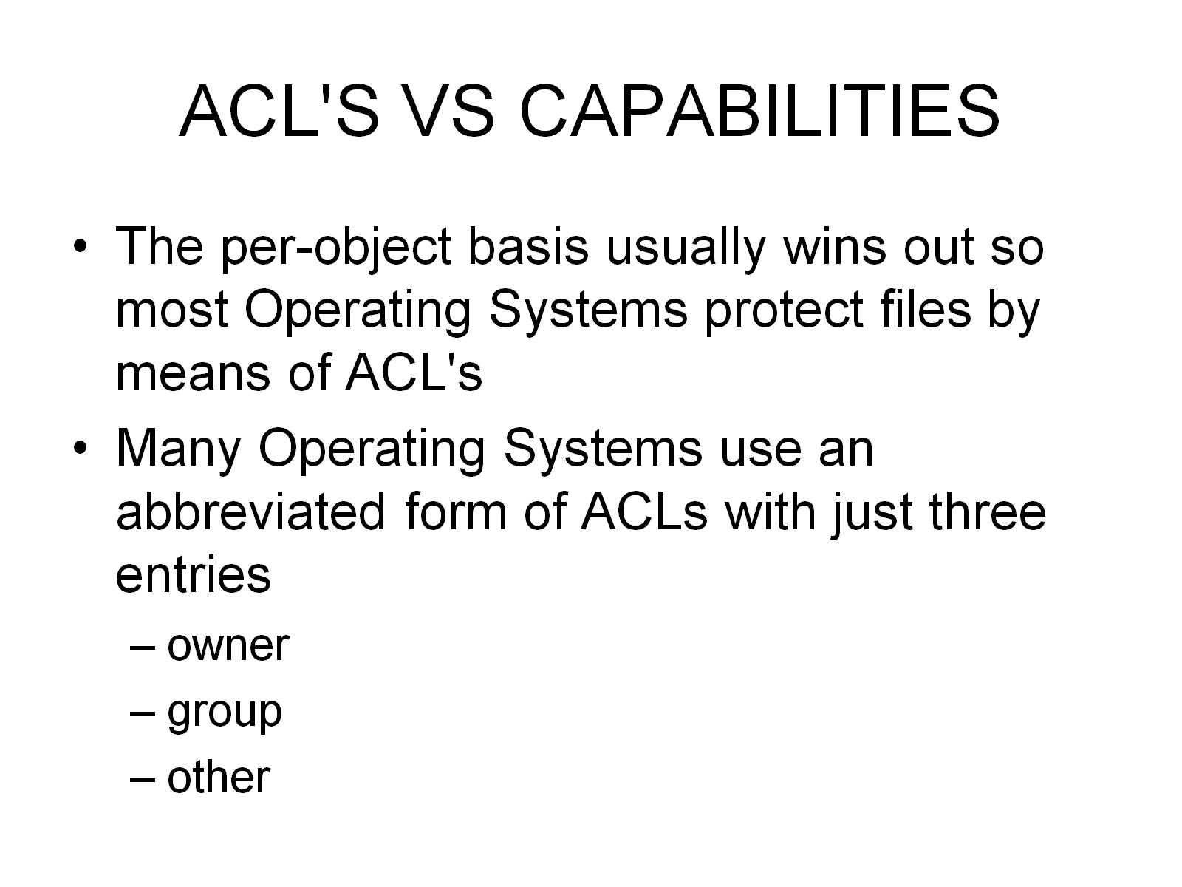
ACL'S VS CAPABILITIES

Slide 15
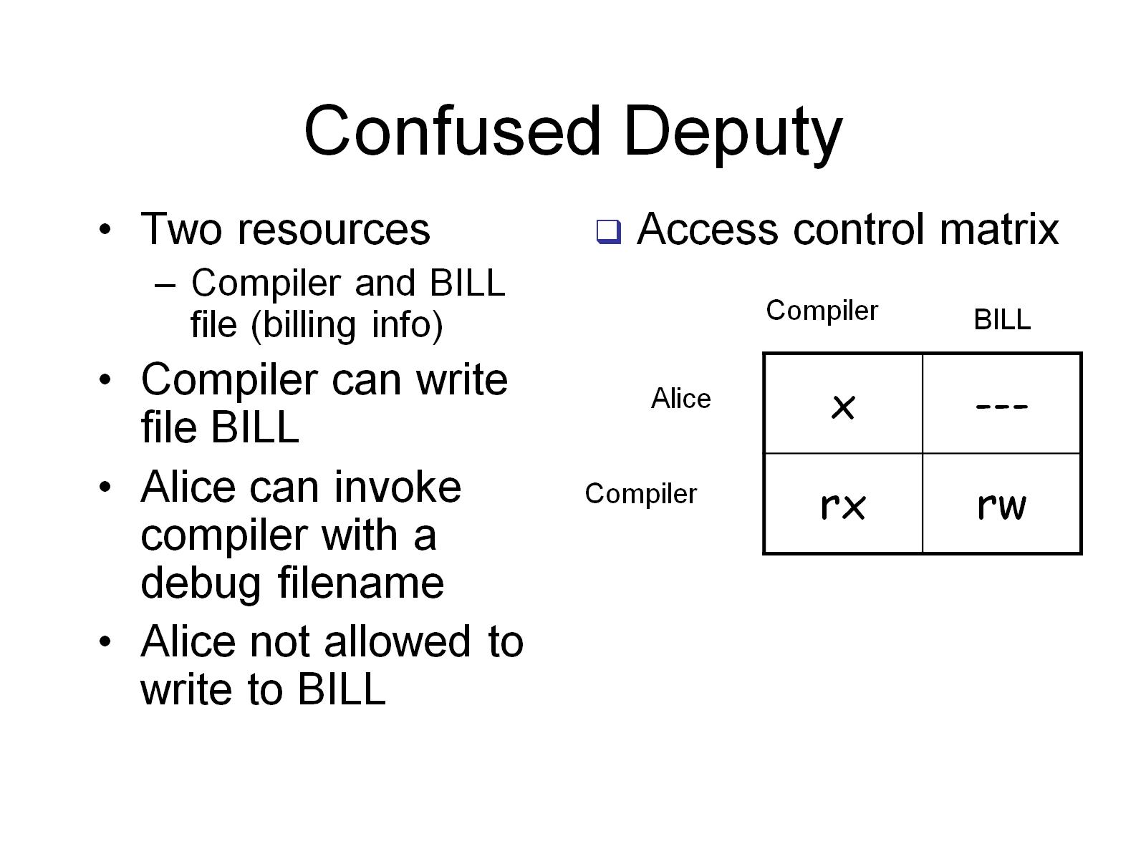
Confused Deputy

Slide 16
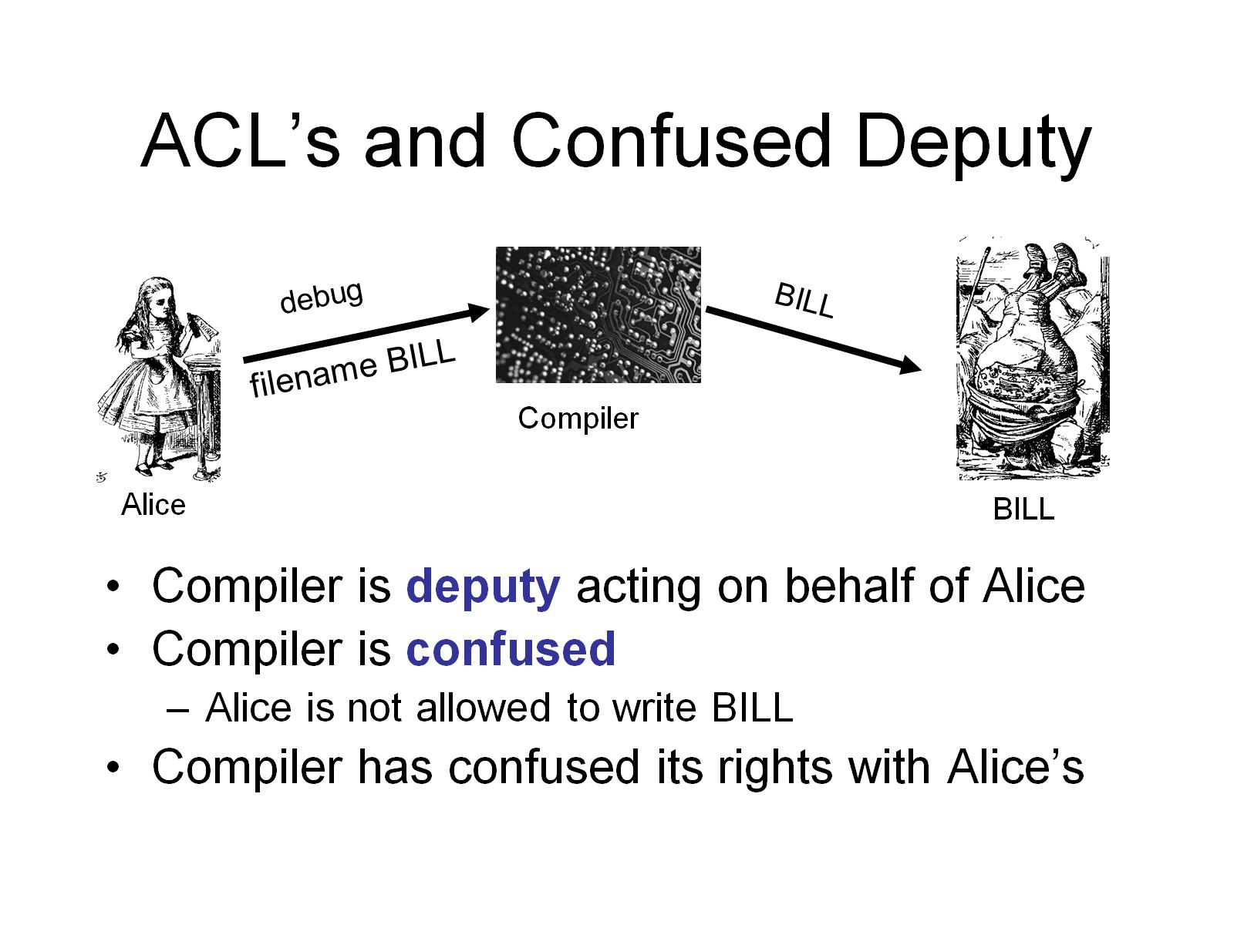
ACL’s and Confused Deputy

Slide 17
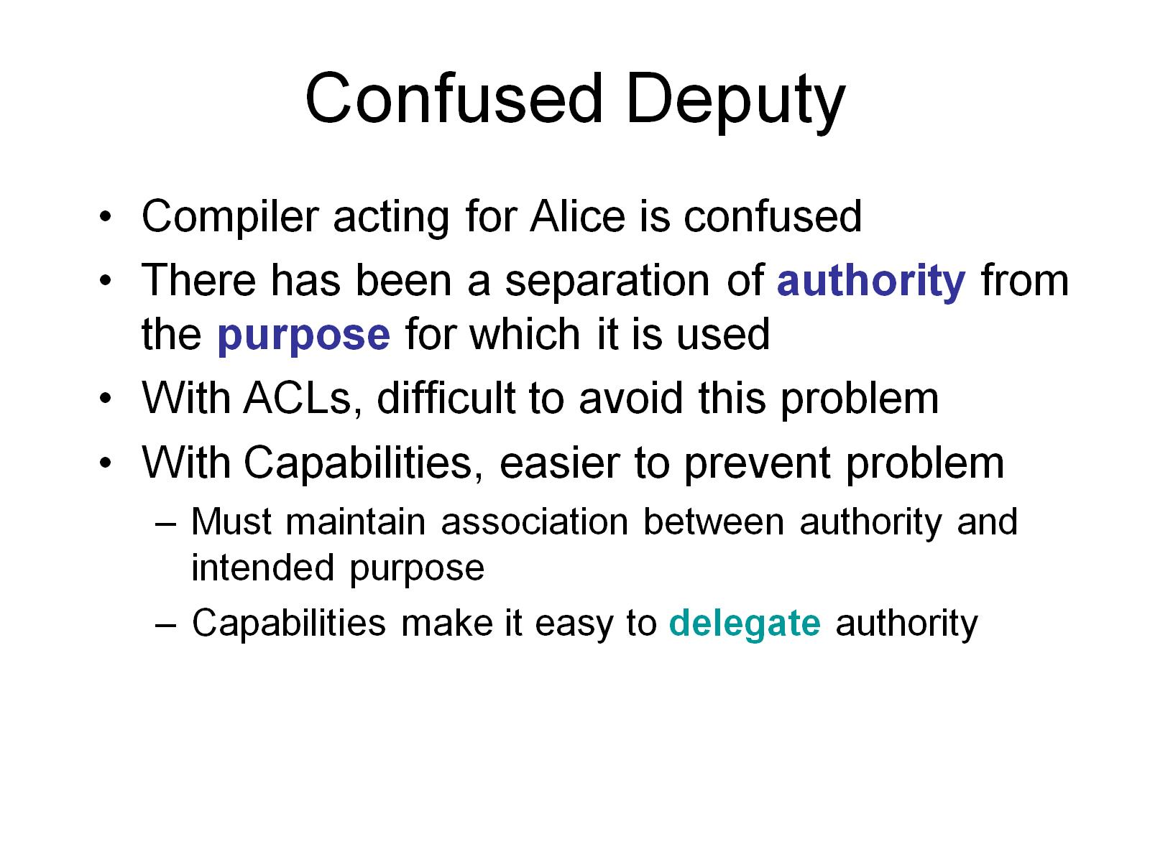
Confused Deputy

Slide 18
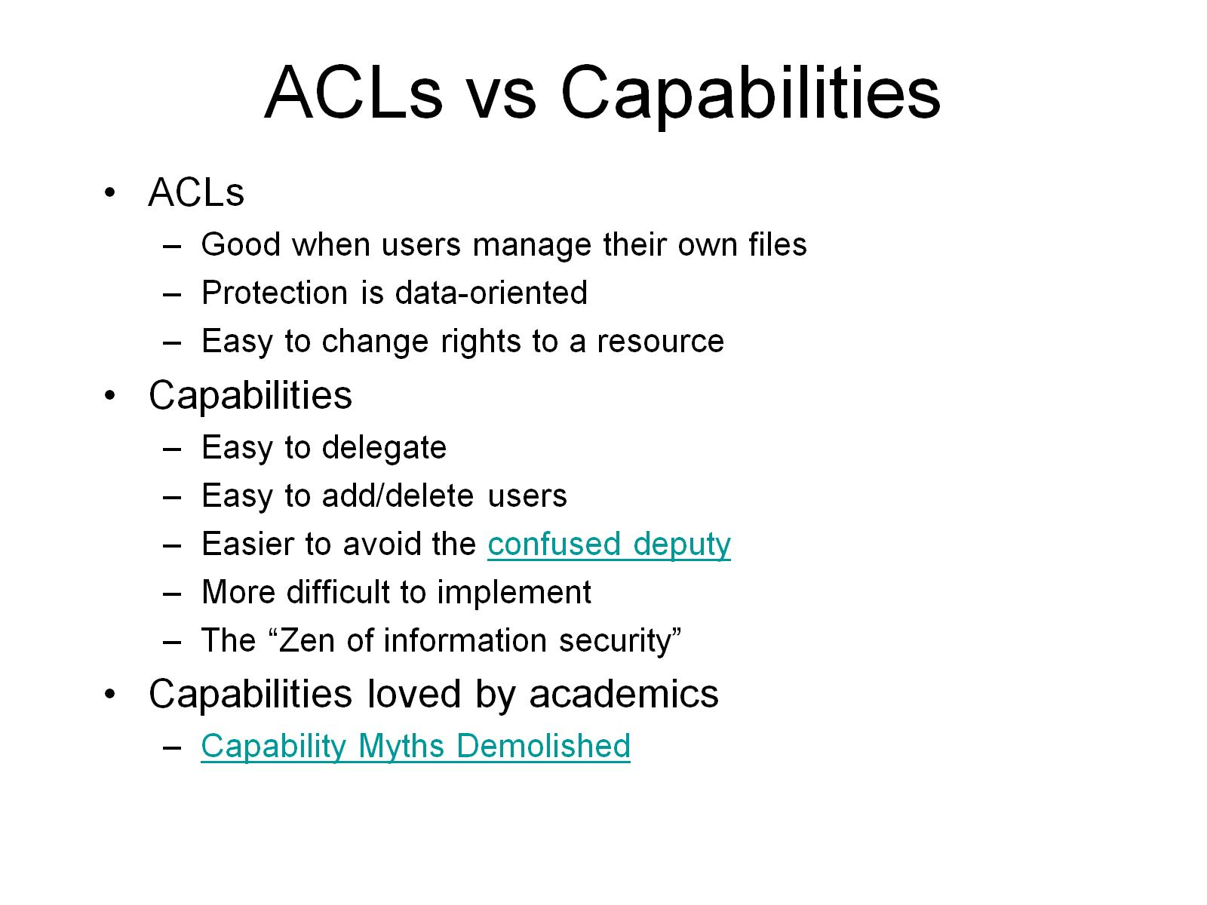
ACLs vs Capabilities

Slide 19
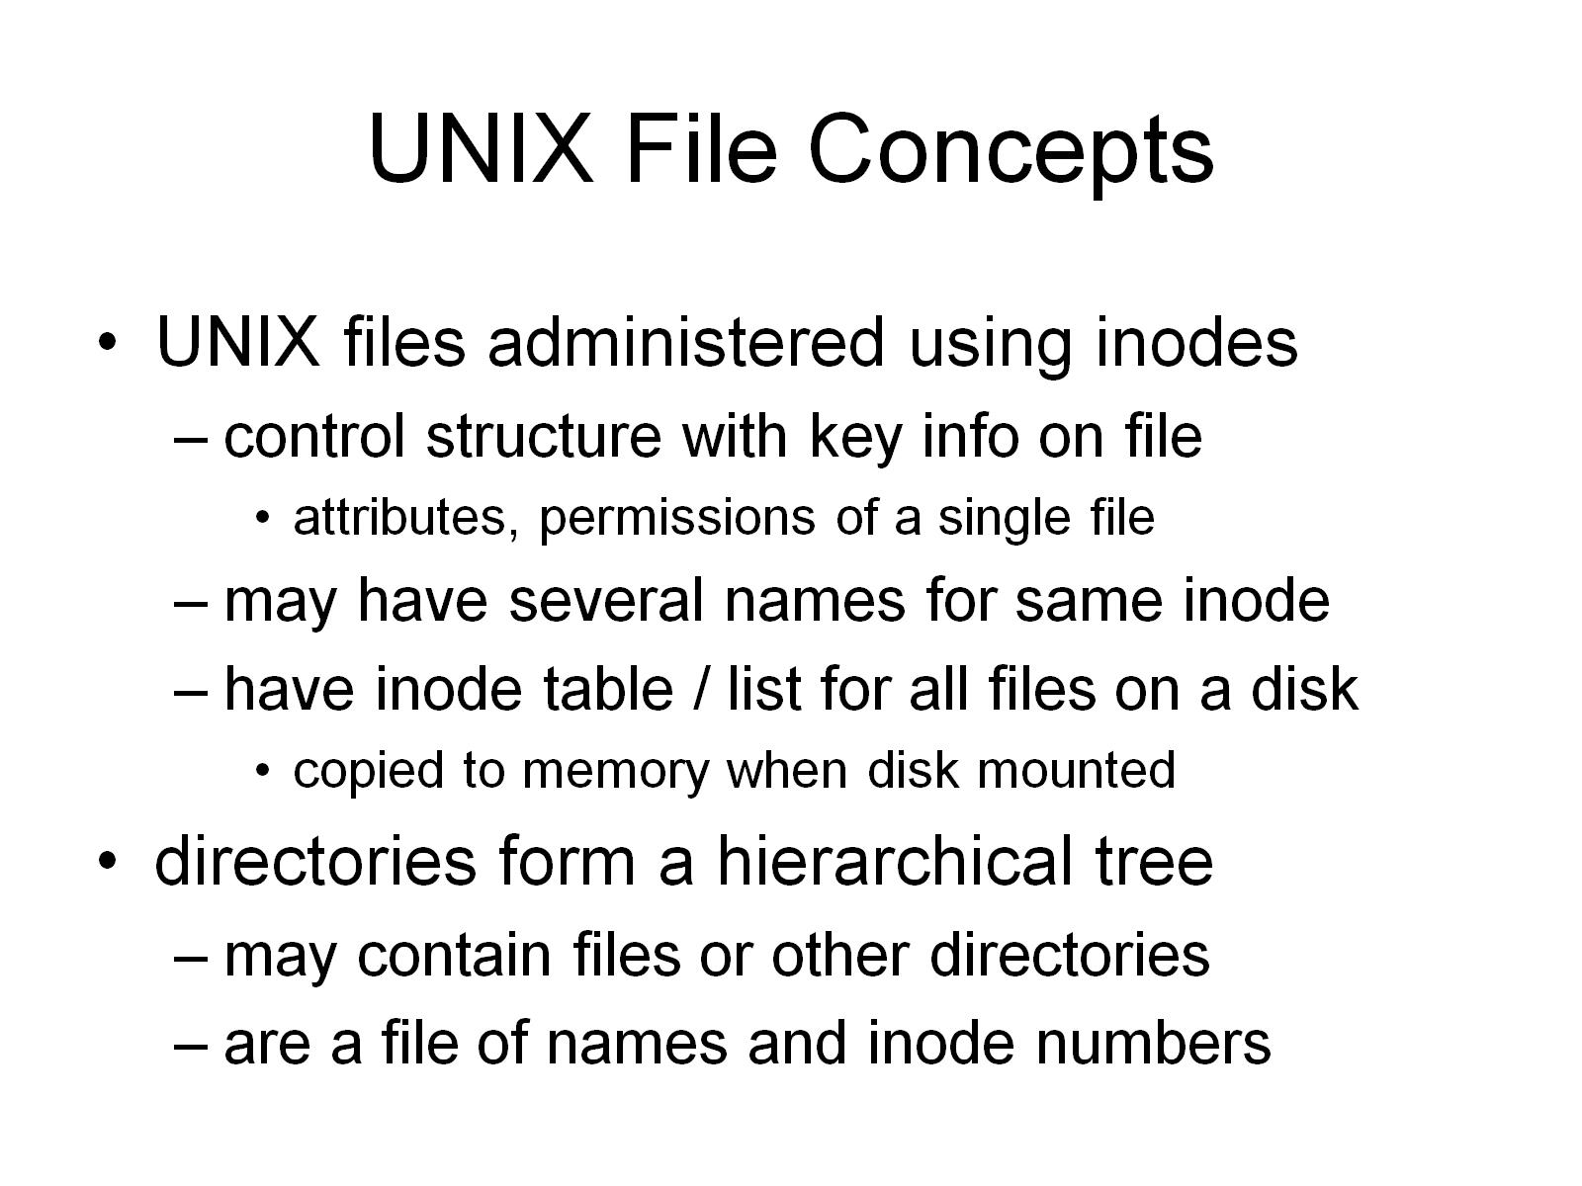
UNIX File Concepts

Slide 20
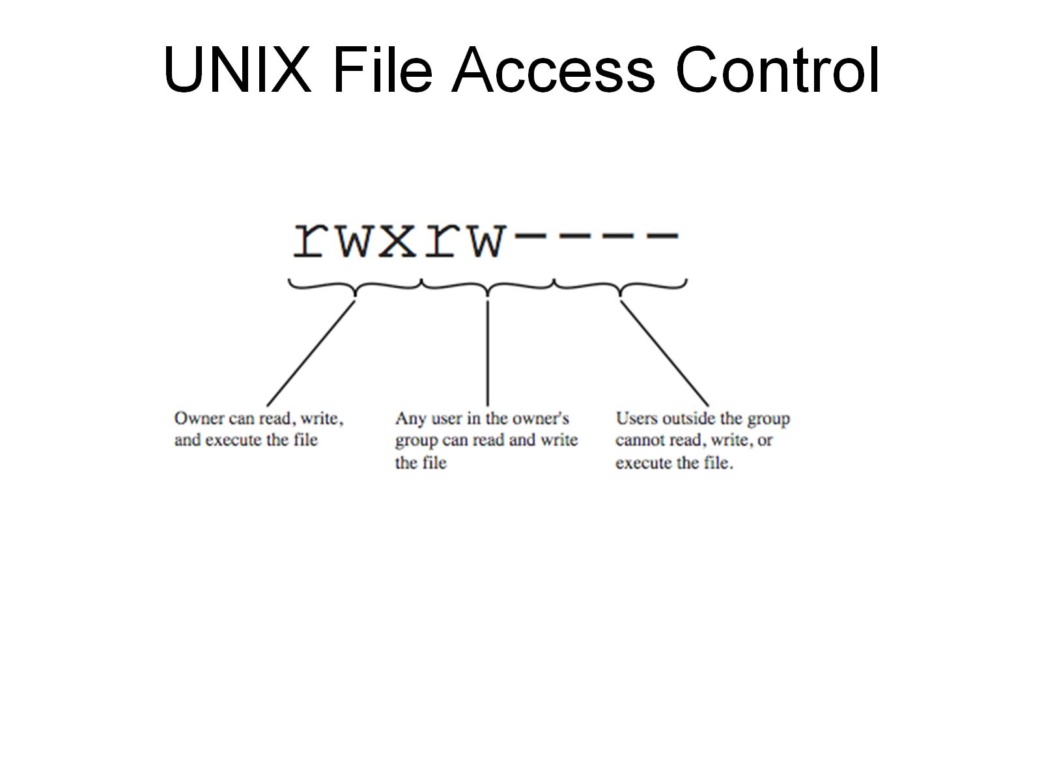
UNIX File Access Control

Slide 21
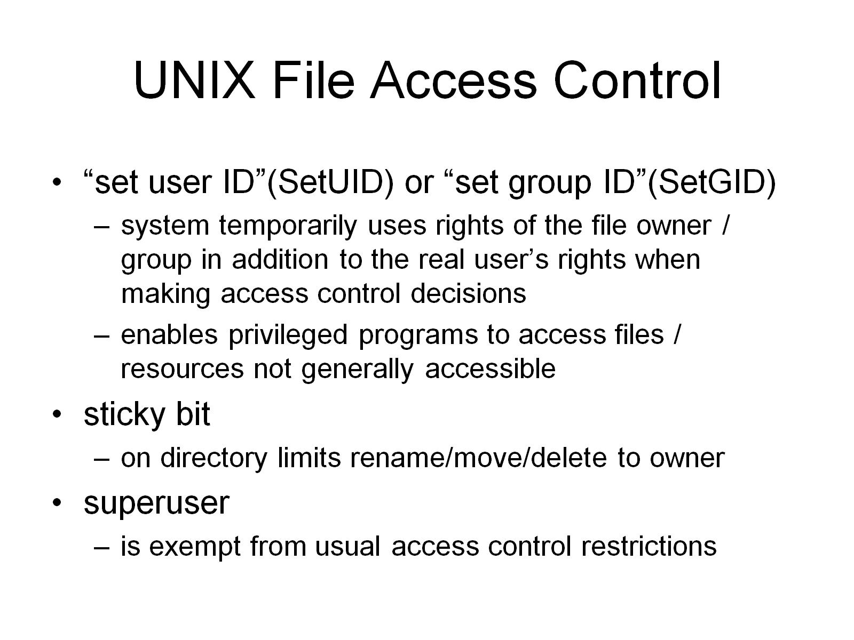
UNIX File Access Control

Slide 22
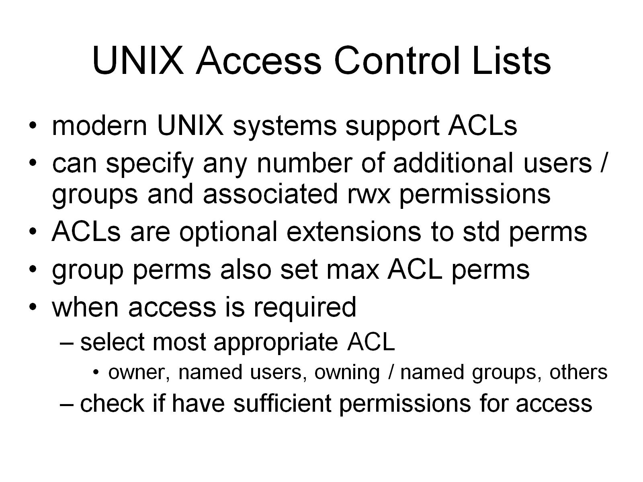
UNIX Access Control Lists

Slide 23
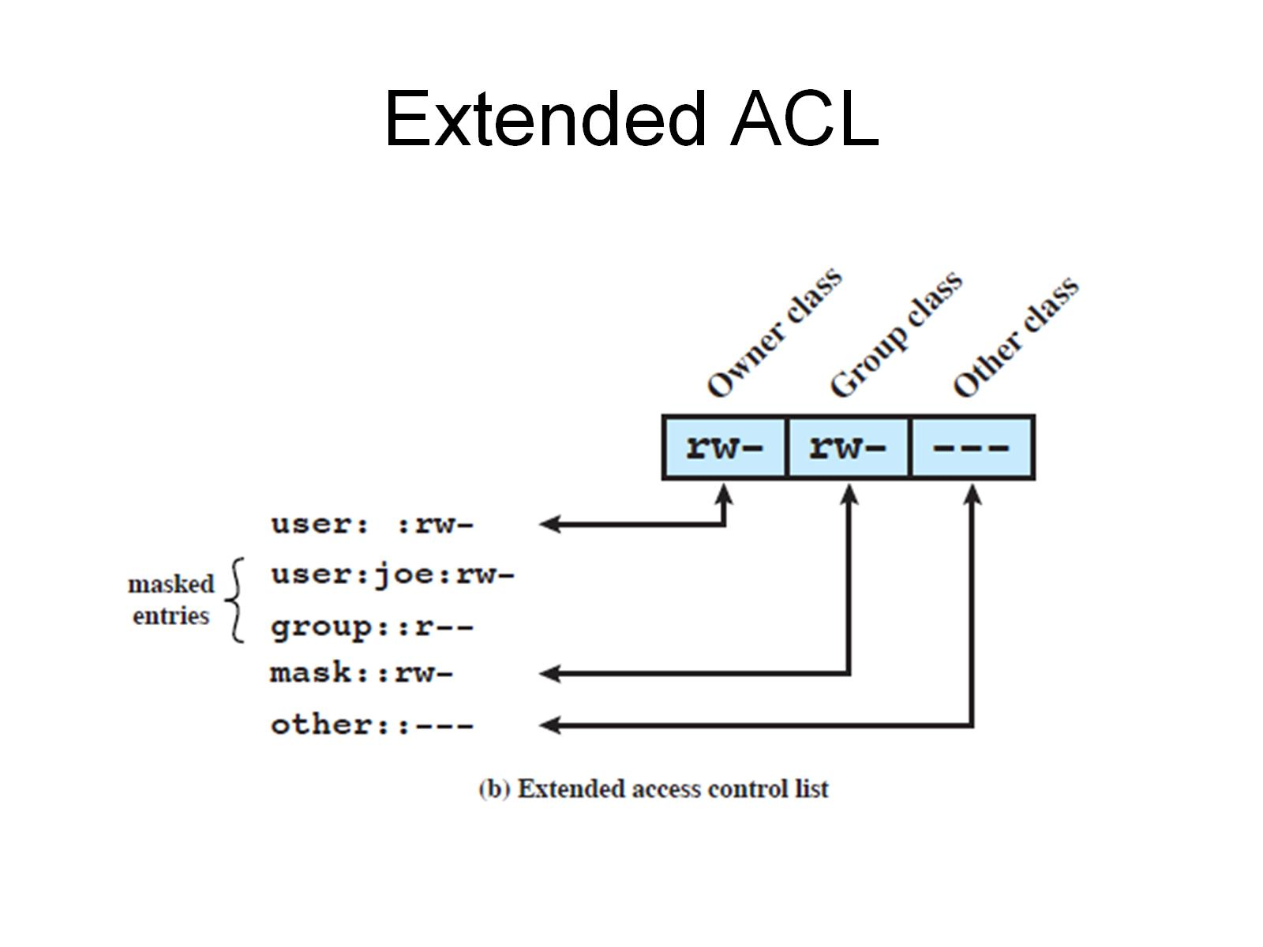
Extended ACL

Slide 24
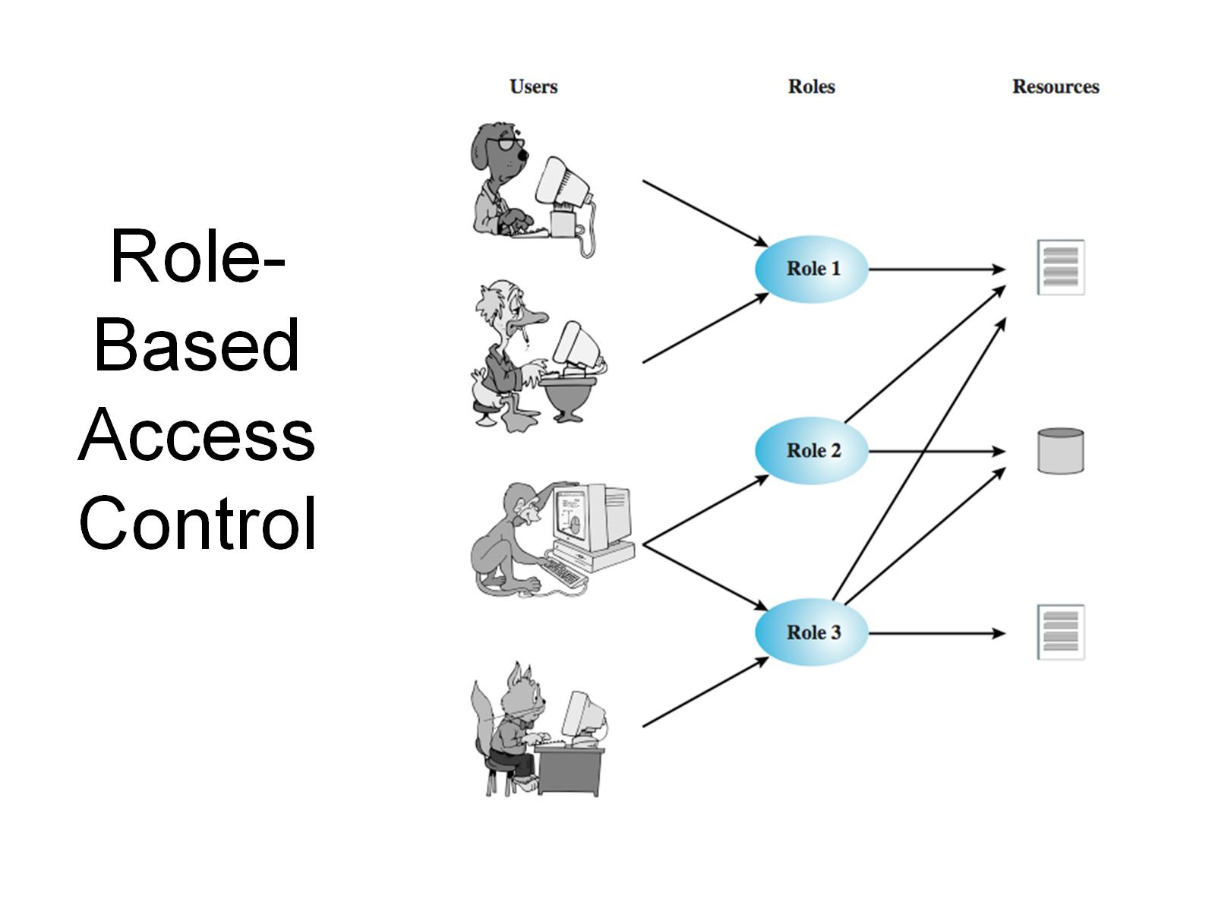
Role-Based Access Control

Slide 25
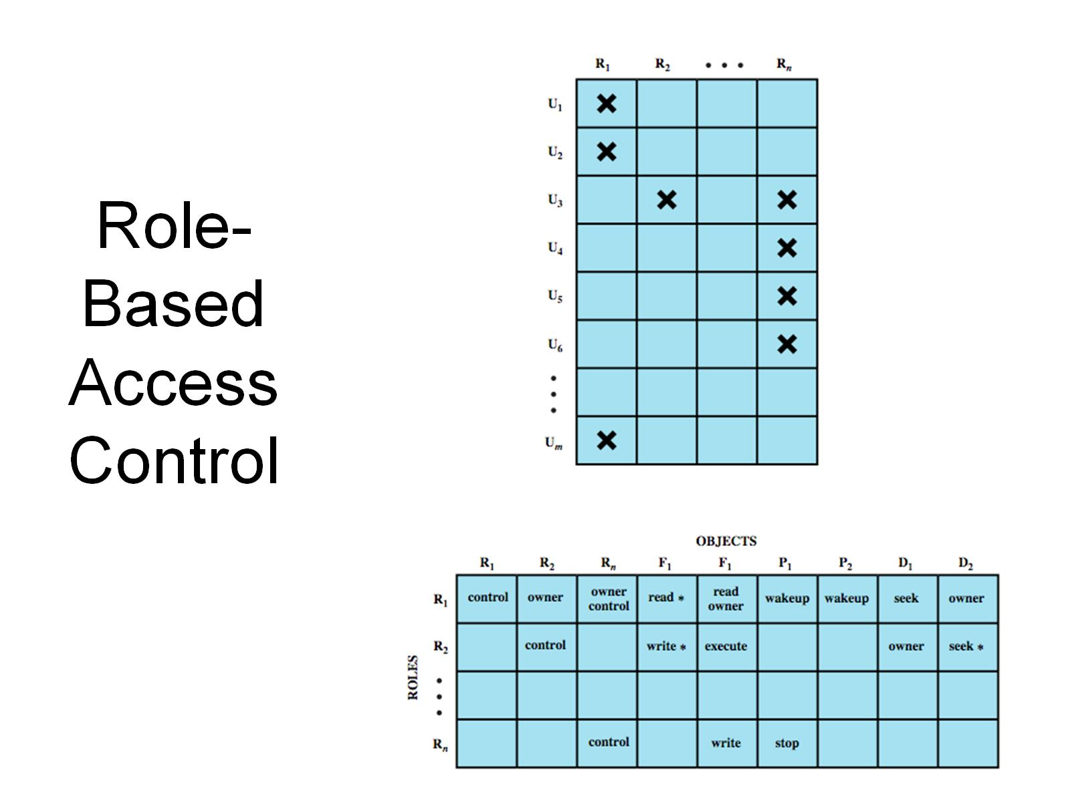
Role-Based Access Control

Slide 26
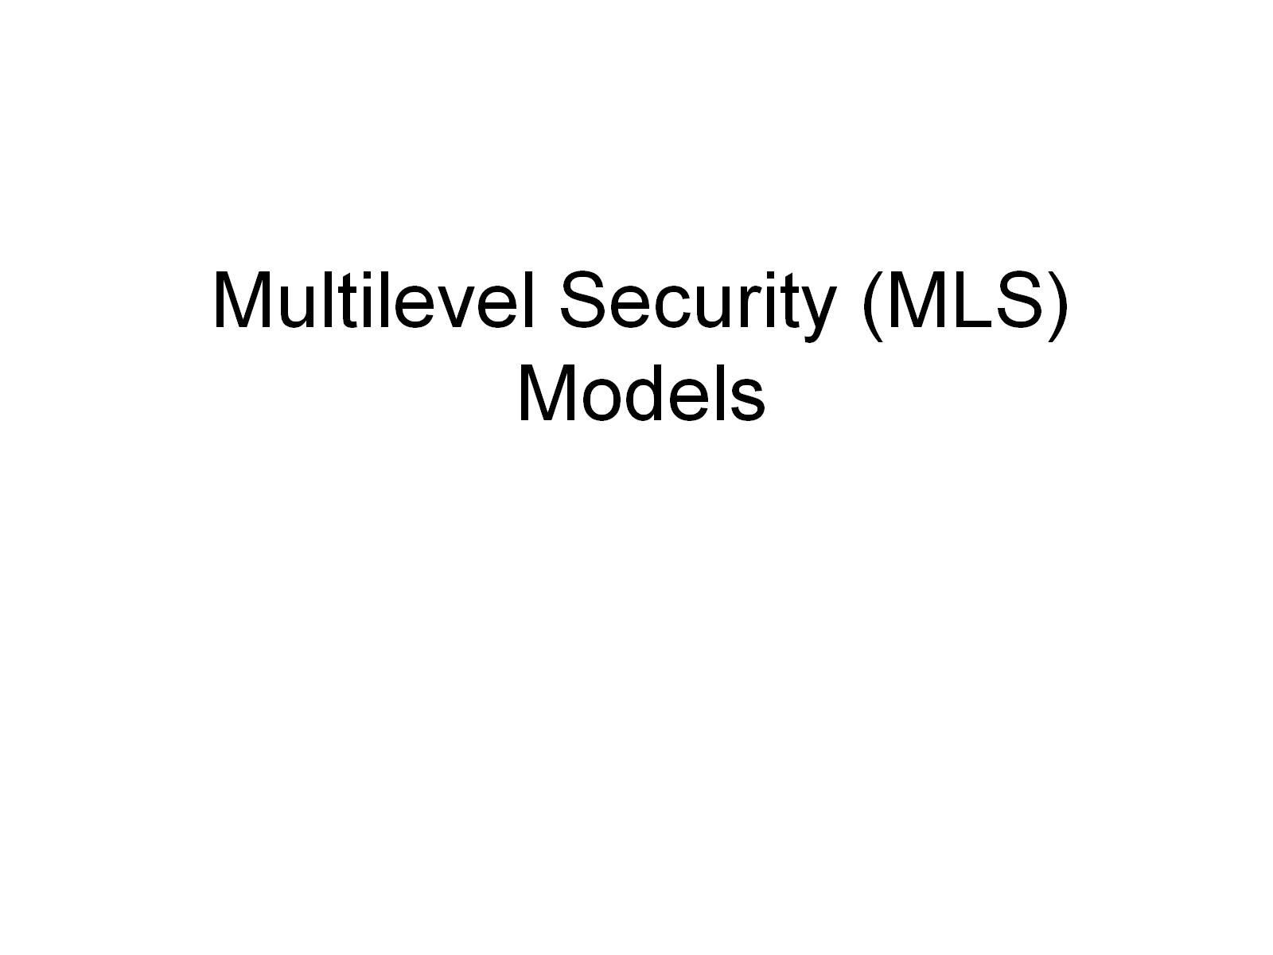
Multilevel Security (MLS) Models

Slide 27
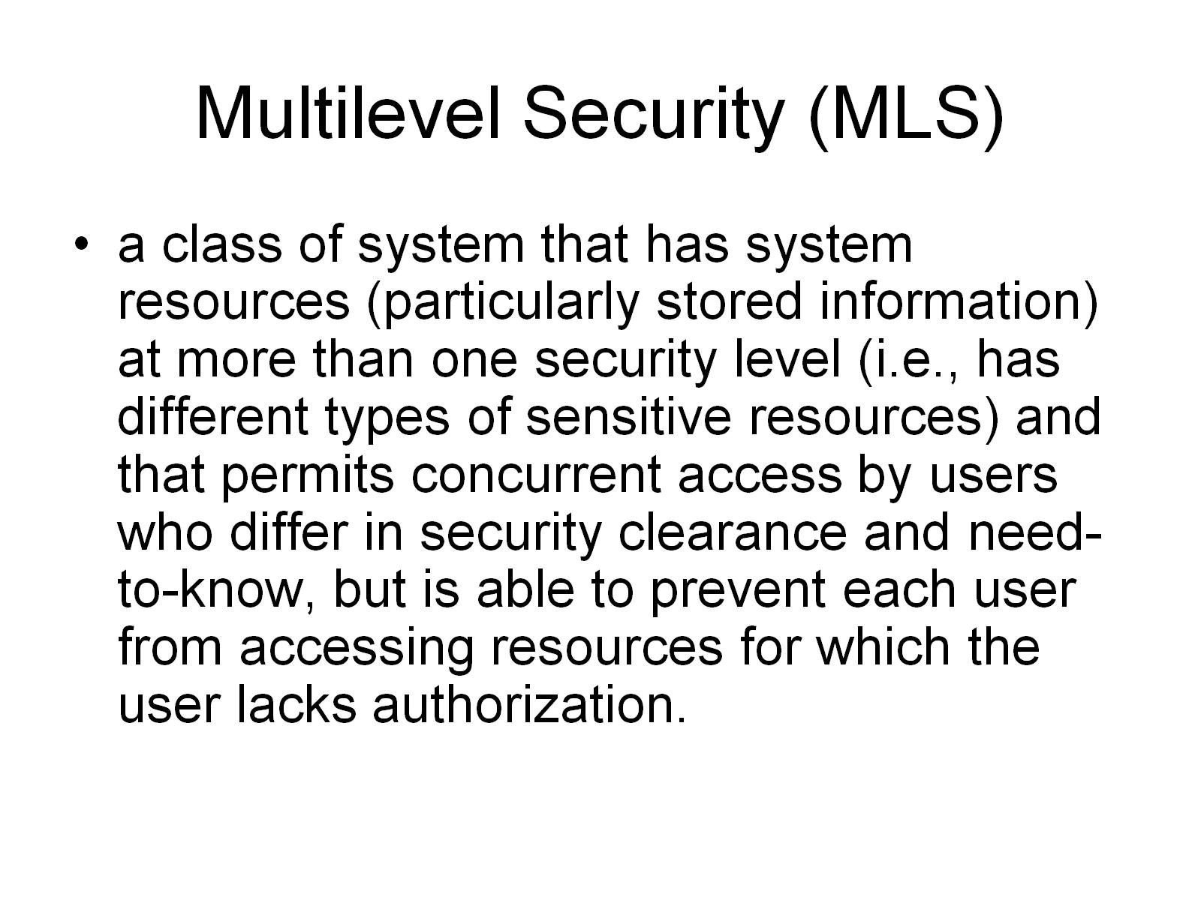
Multilevel Security (MLS)

Slide 28
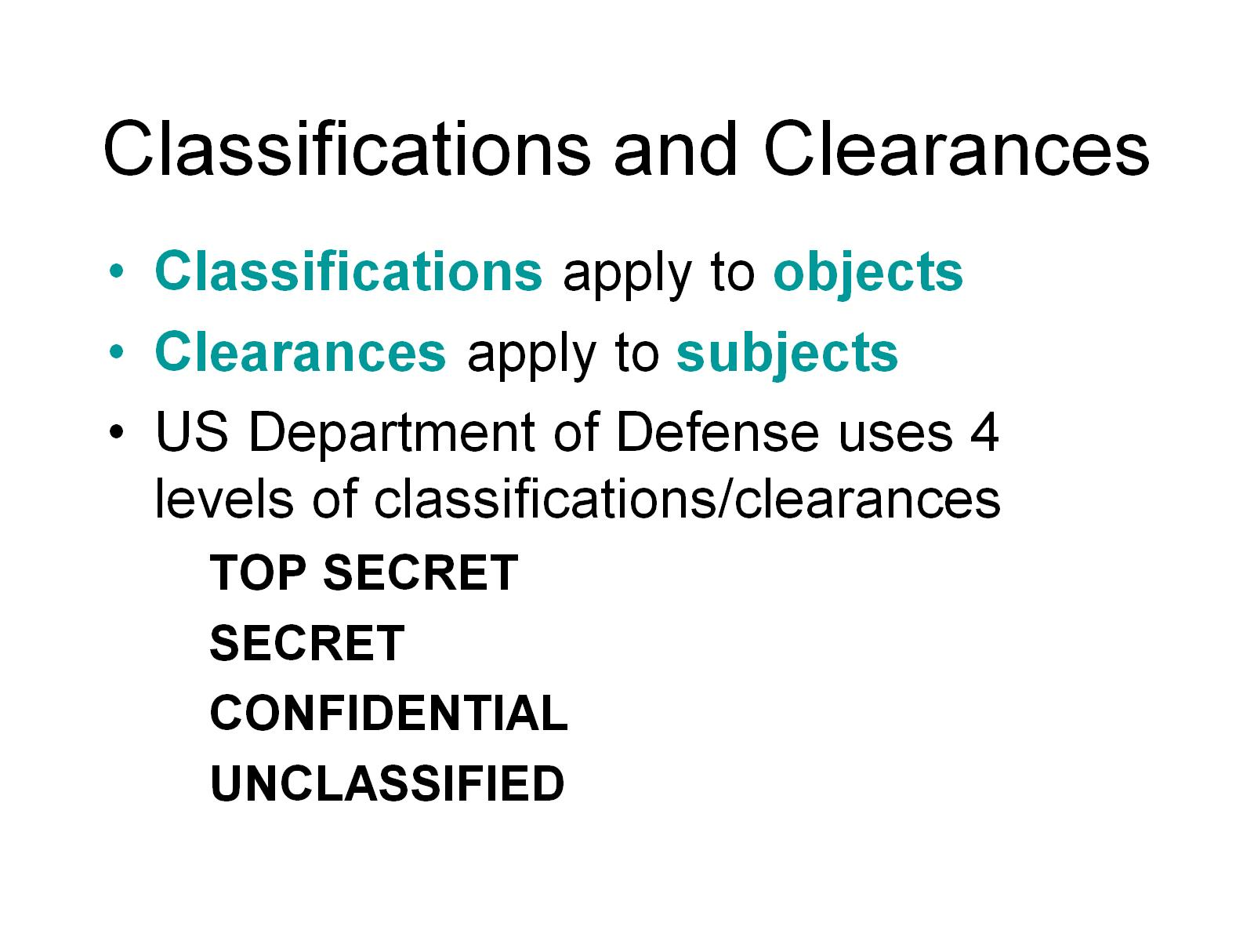
Classifications and Clearances

Slide 29
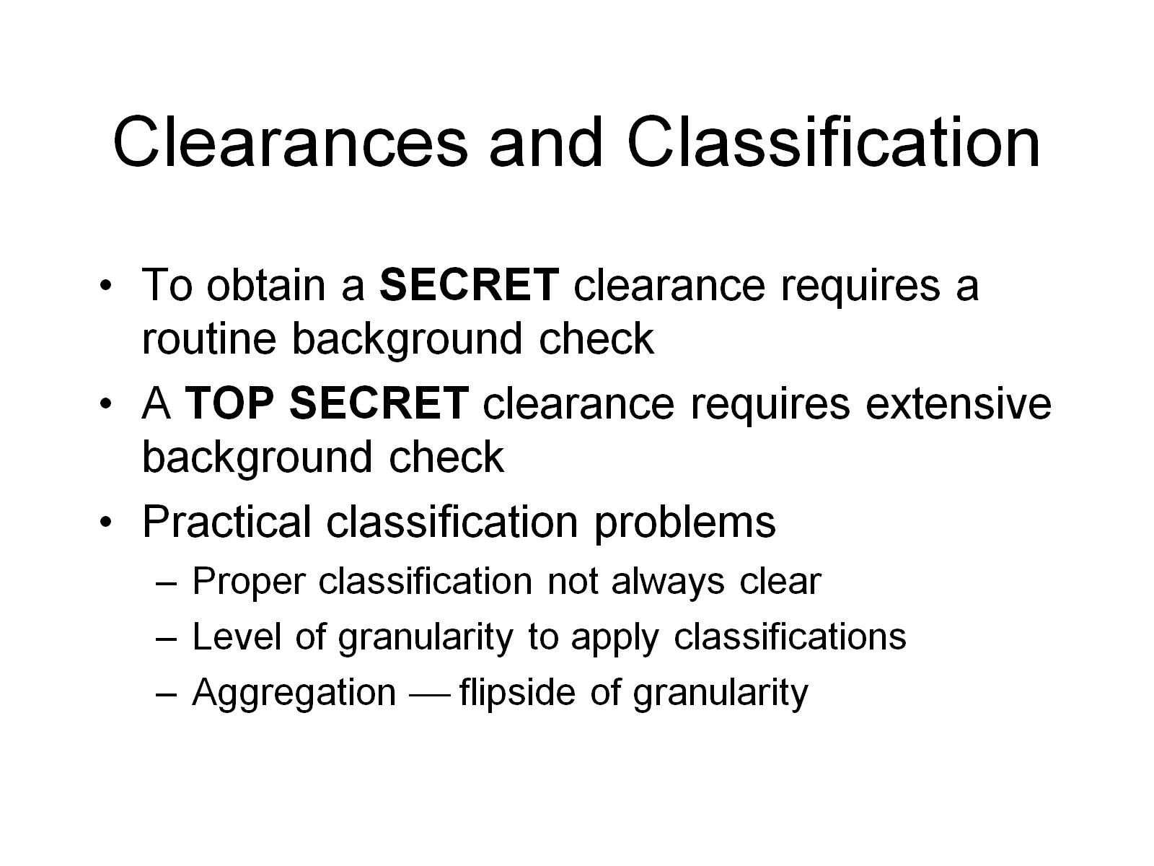
Clearances and Classification

Slide 30
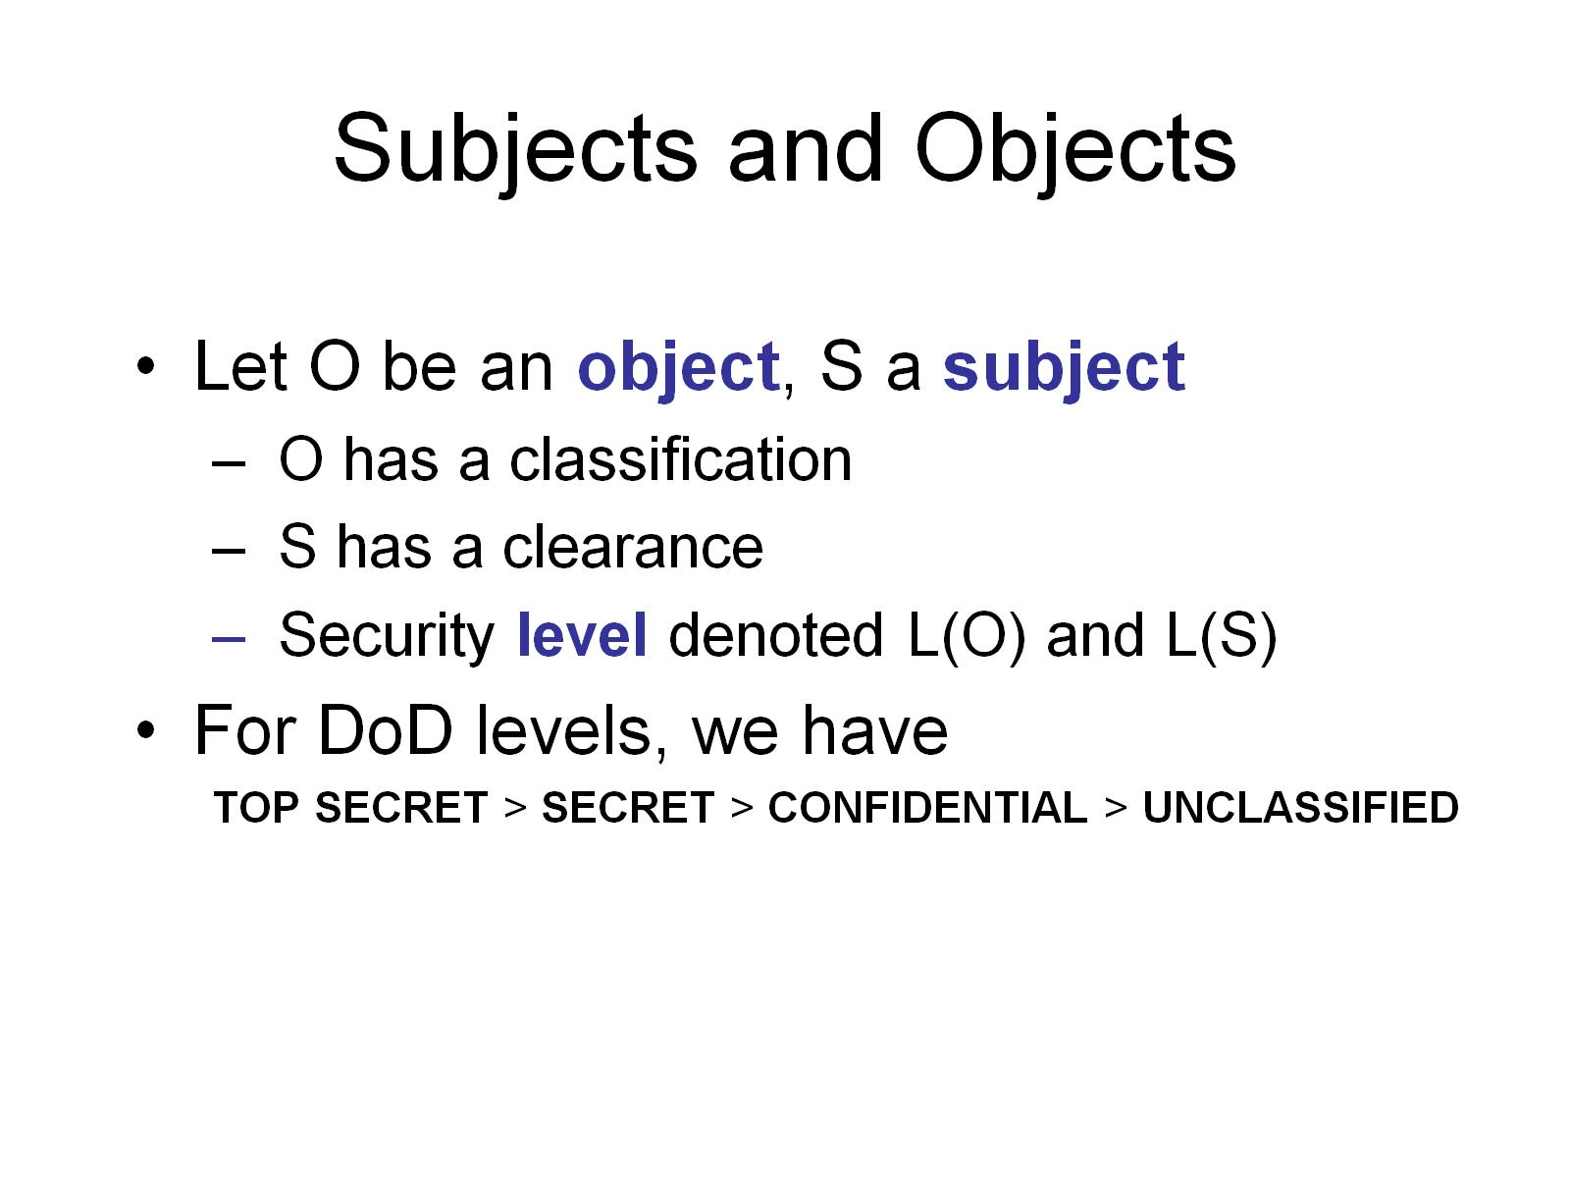
Subjects and Objects

Slide 31
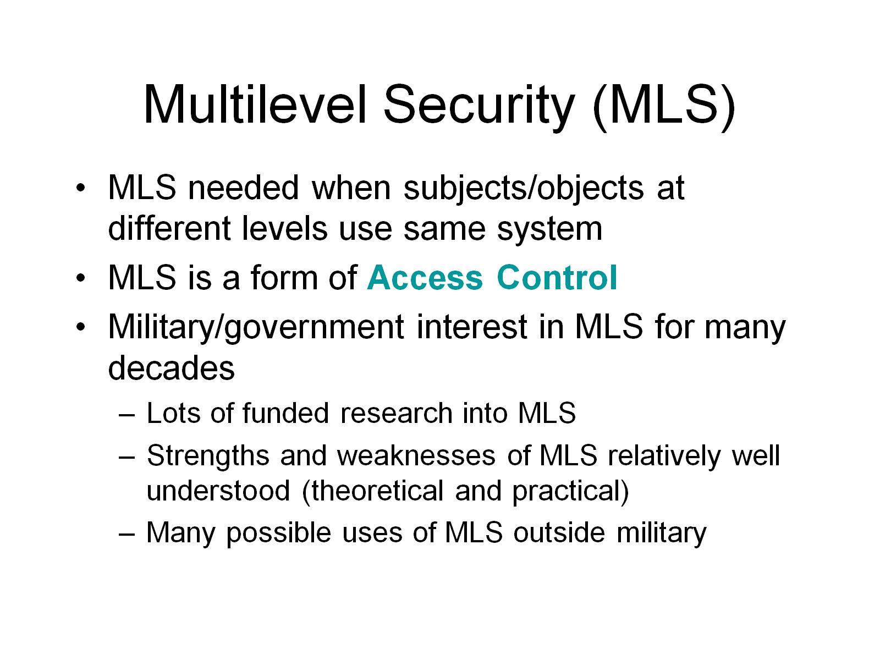
Multilevel Security (MLS)

Slide 32
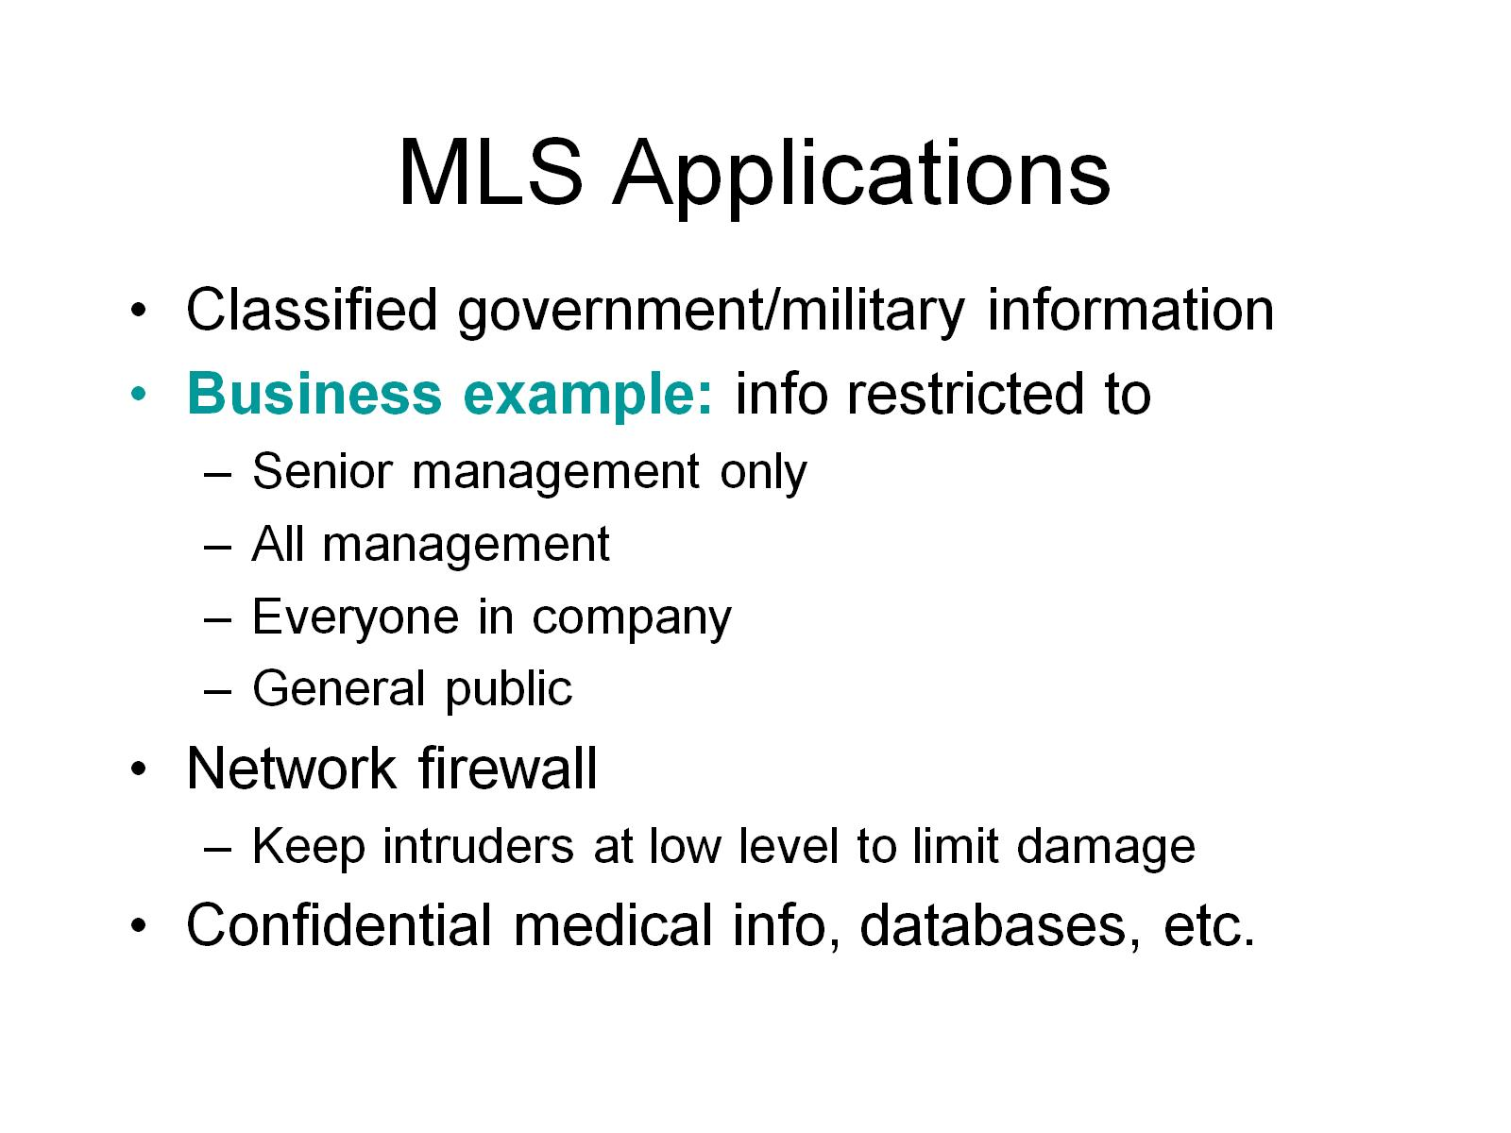
MLS Applications

Slide 33
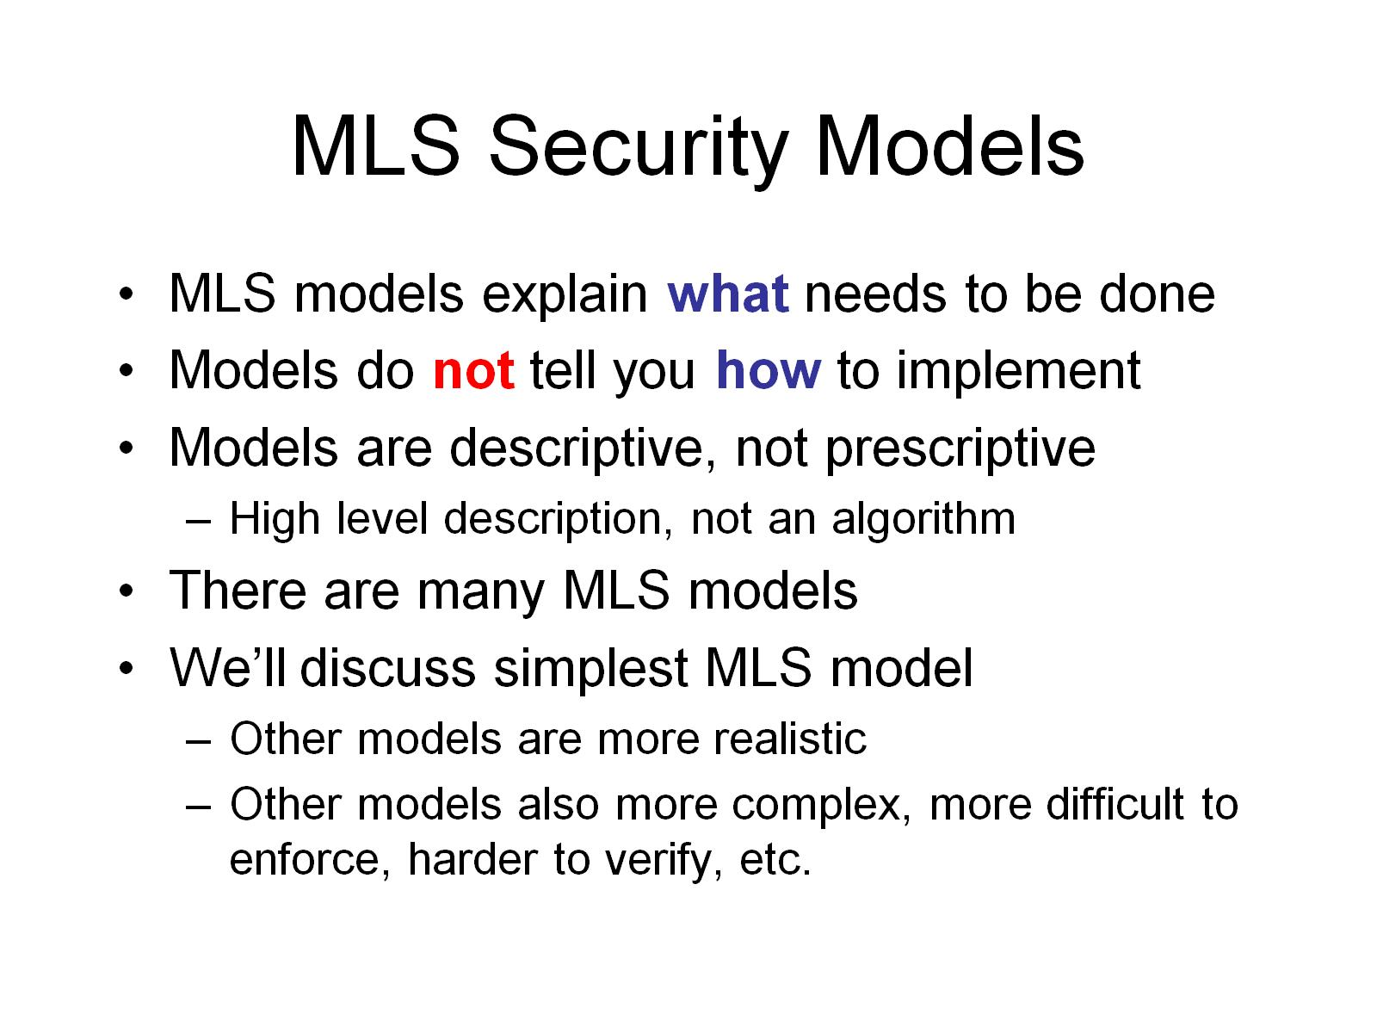
MLS Security Models

Slide 34
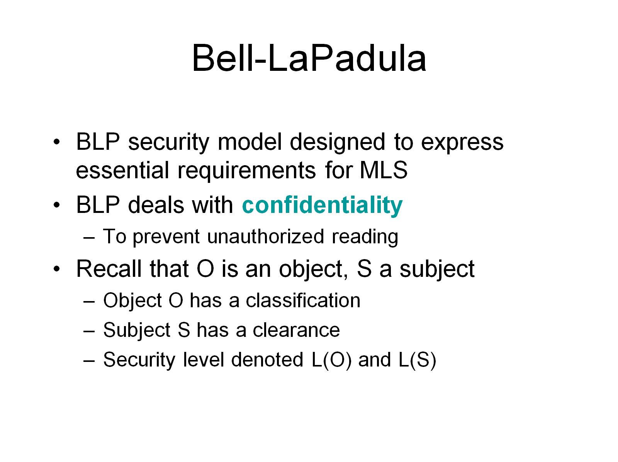
Bell-LaPadula

Slide 35
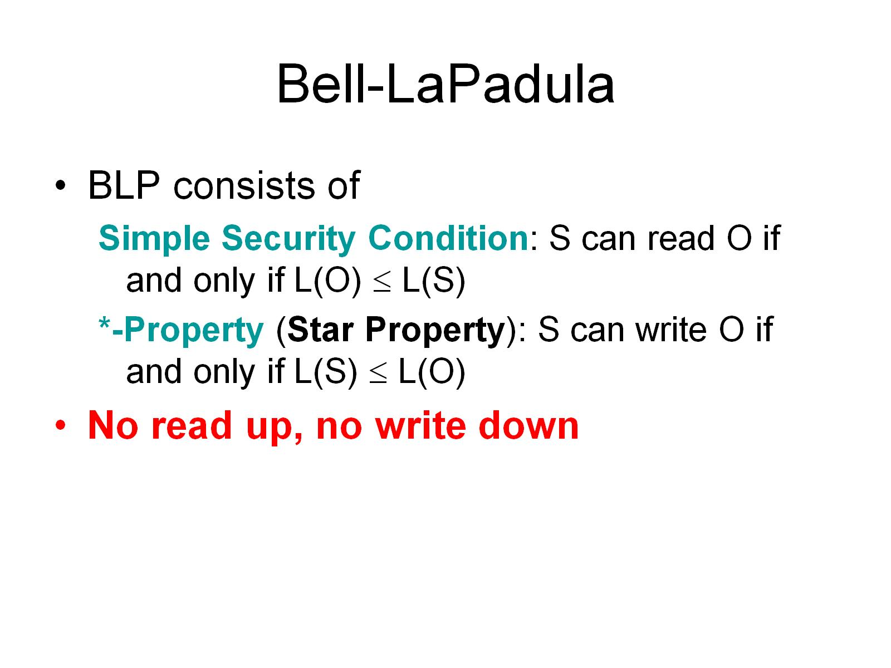
Bell-LaPadula

Slide 36
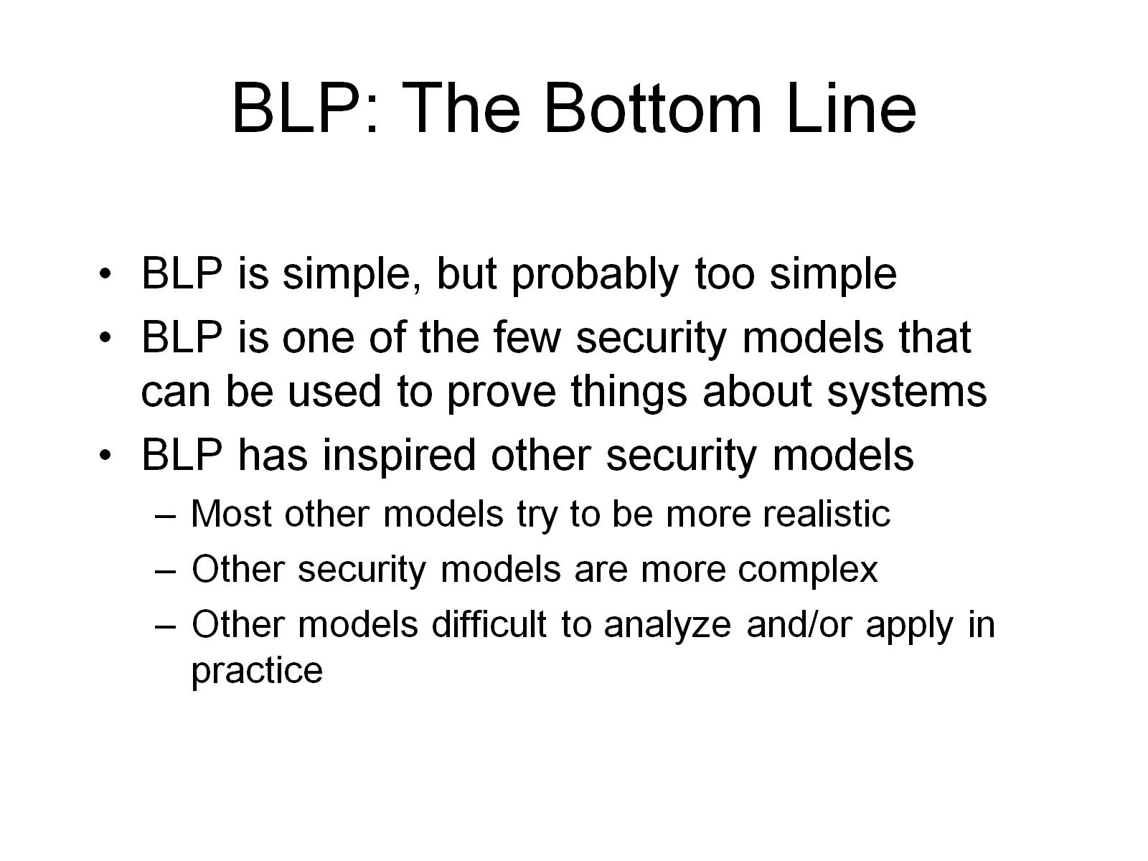
BLP: The Bottom Line

Slide 37
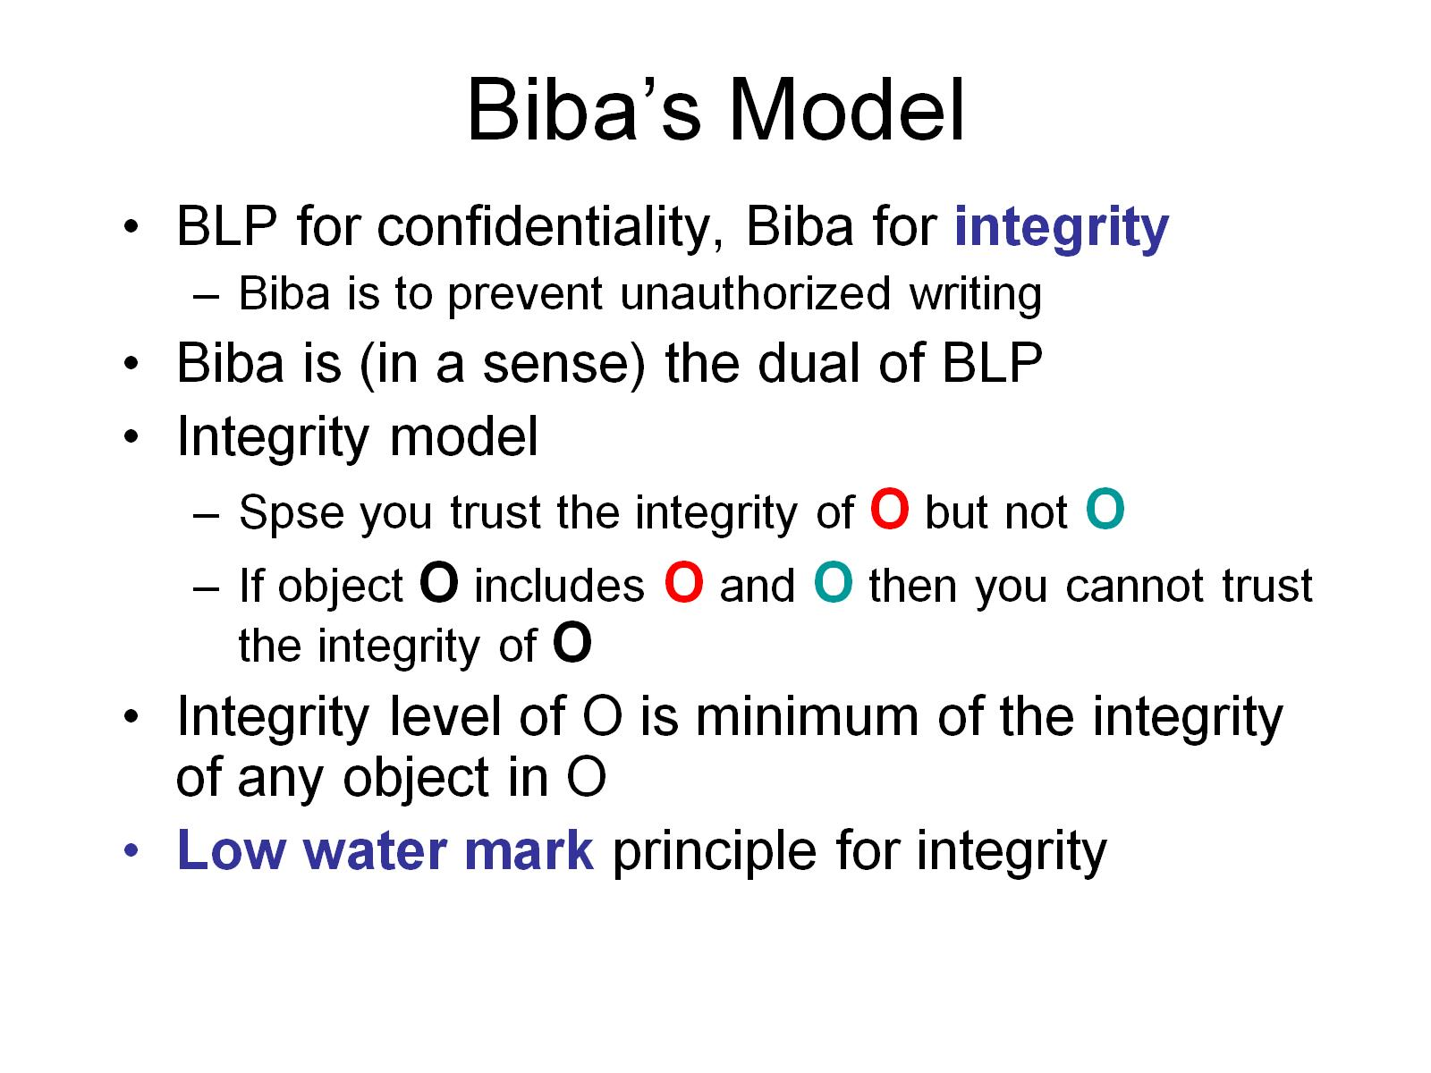
Biba’s Model

Slide 38
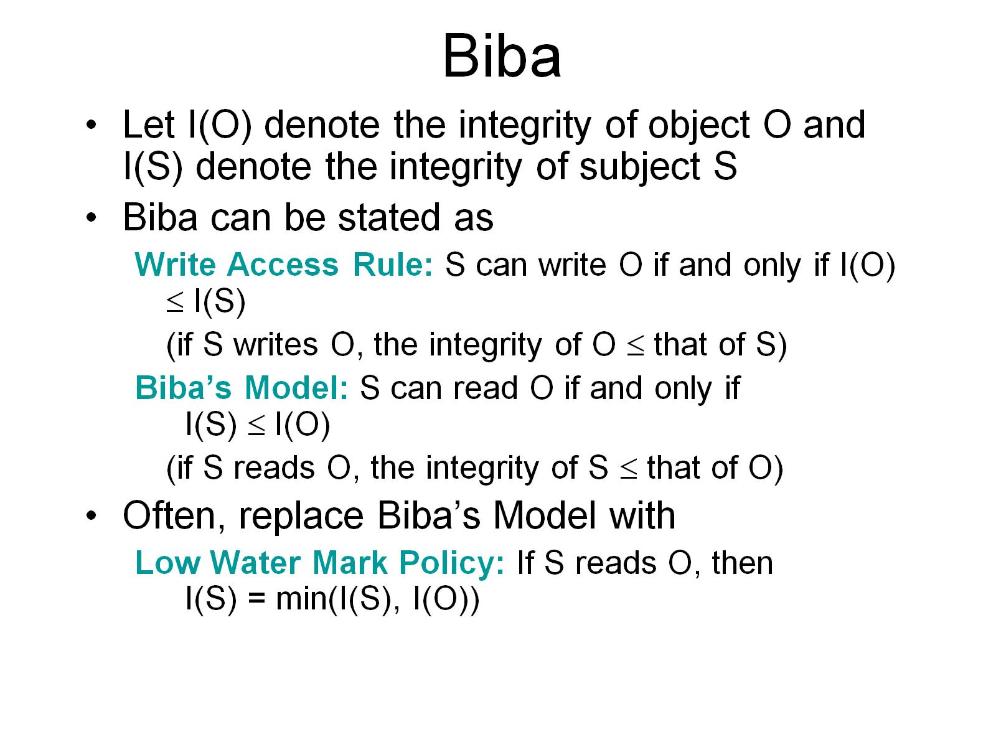
Biba

Slide 39
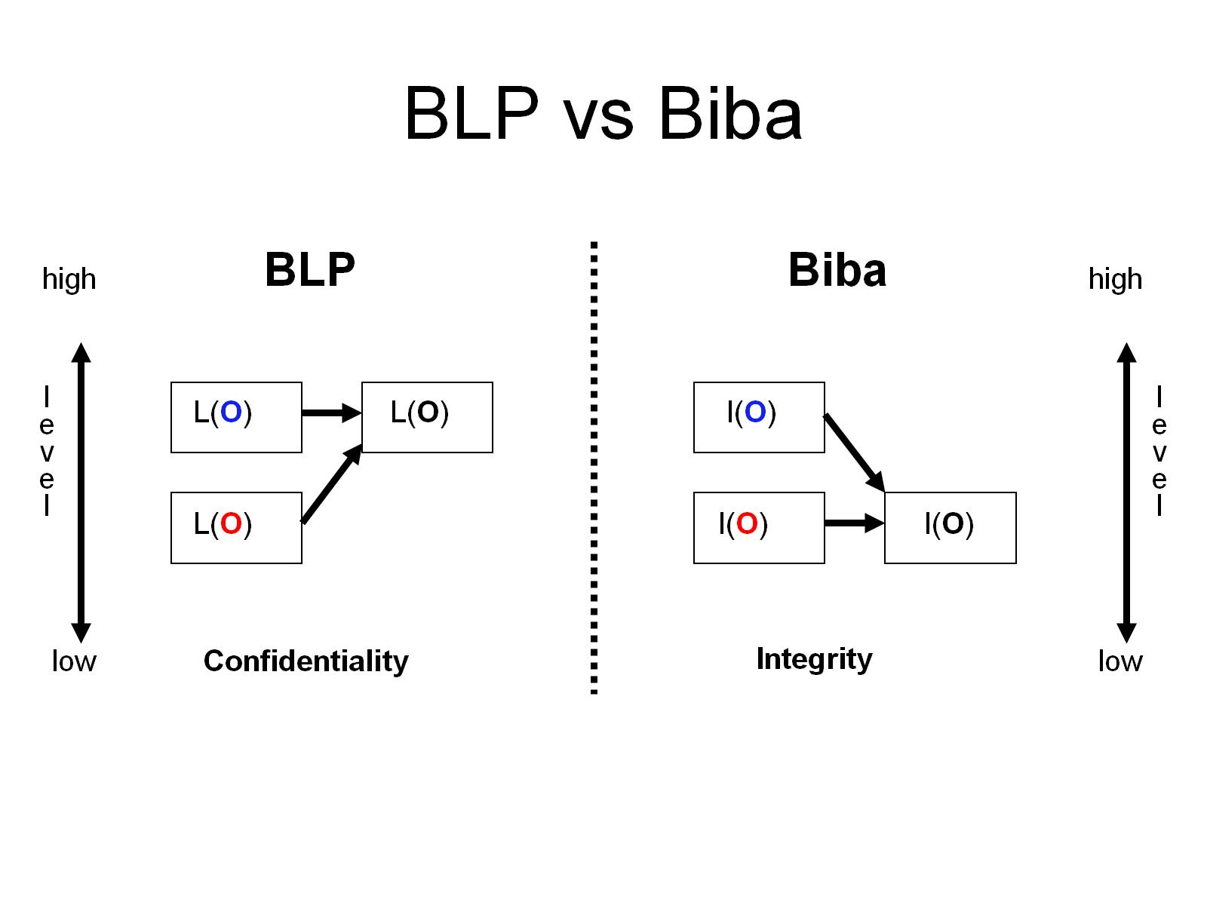
BLP vs Biba

Slide 40
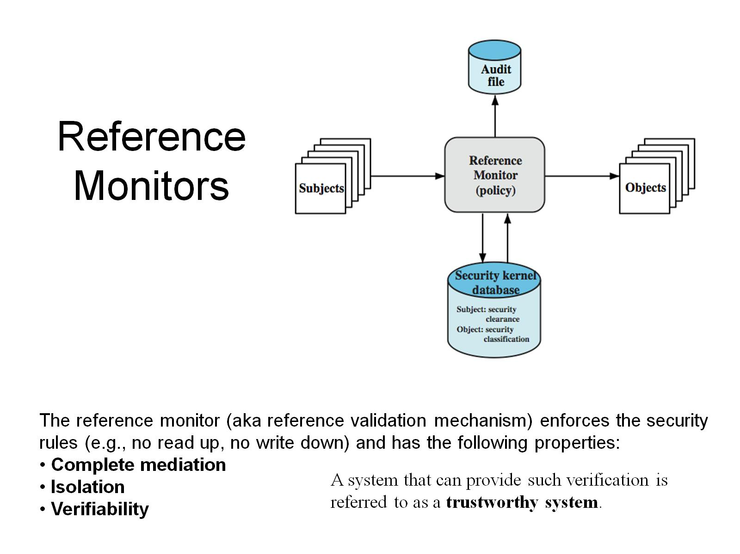
Reference Monitors
Notes:
The concept of trust in the context of computer security goes back to the early 1970s, spurred on by the U.S. Department of Defense initiative and funding in this area. Initial work on trusted computers and trusted operating systems was based on the reference monitor concept, depicted in Figure 10.7. The reference monitor is a controlling element in the hardware and operating system of a computer that regulates the access of subjects to objects on the basis of security parameters of the subject and object. It has access to a file, known as the security kernel database, that lists the access privileges (security clearance) of each subject and the protection attributes (classification level) of each object. The reference monitor enforces the security rules (no read up, no write down) and has the following properties:
• Complete mediation: security rules enforced on every access, not just file open.
• Isolation: reference monitor & database protected from unauthorized modification.
• Verifiability: reference monitor's correctness must be provable.
These are stiff requirements. A system that can provide such verification is referred to as a trustworthy system.
A final element illustrated in Figure 10.7 is an audit file. Important security events, such as detected security violations and authorized changes to the security kernel database, are stored in the audit file.

Slide 41
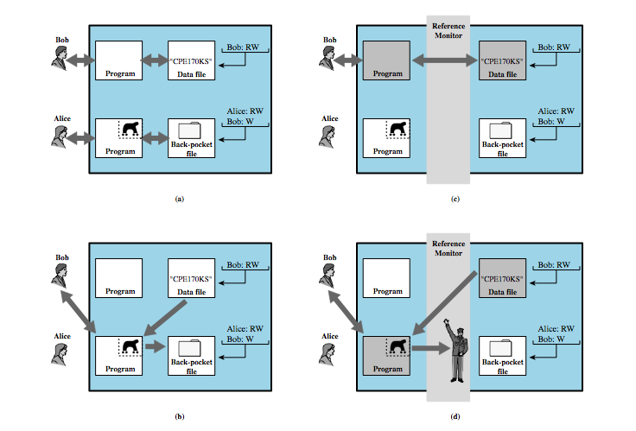
Trojan Horse Defense
Notes:
One way to prevent Trojan horse attacks is to use a secure, trusted operating system. Figure 10.8 illustrates an example of a Trojan horse used to bypass security mechanisms. In this example, a user Bob interacts with a data file containing the critically sensitive character string "CPE170KS." Bob has created it with read/write permission provided only to his programs. The Trojan horse attack begins when a hostile user, Alice, gains legitimate access to the system and installs both a Trojan horse program and a private file used in the attack as a "back pocket." Alice gives read/write permission to herself for this file and gives Bob write-only permission (Figure 10.8a). Alice now induces Bob to invoke the Trojan horse program, perhaps by advertising it as a useful utility. When the program detects that it is being run by Bob, it reads the sensitive character string from Bob's file and copies it into Alice's back-pocket file (Figure 10.8b). Both the read and write operations satisfy the constraints imposed by access control lists. Alice then has only to access Bob's file at a later time to learn the value of the string. Now consider the use of a secure operating system (Figure 10.8c). Security levels, e.g. sensitive and public, are assigned to subjects at logon. Processes owned by Bob and Bob's data file are assigned the security level sensitive. Alice's file and processes are restricted to public. If Bob invokes the Trojan horse program (Figure 10.8d), that program acquires Bob's security level. It is therefore able, under the simple security property, to observe the sensitive character string. When the program attempts to store the string in a public file (the back-pocket file), however, the *-Property is violated and the attempt is disallowed by the reference monitor. Thus, the attempt to write into the back-pocket file is denied even though the access control list permits it: The security policy takes precedence over the access control list mechanism.

Slide 42
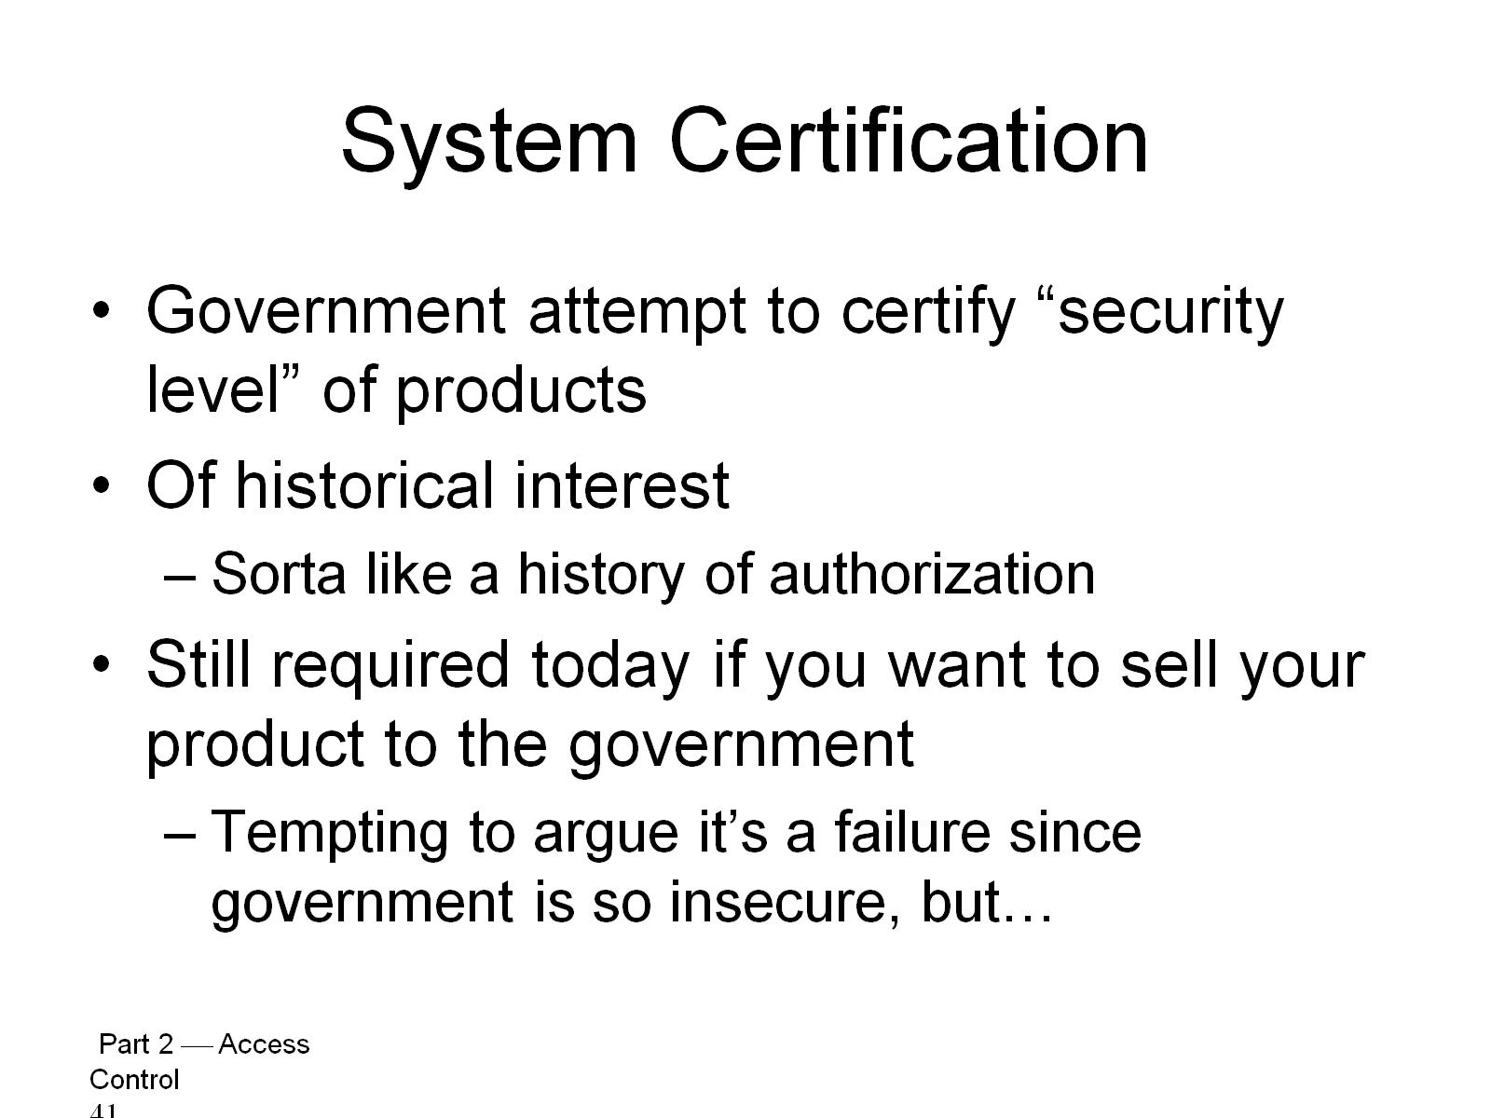
System Certification

Slide 43
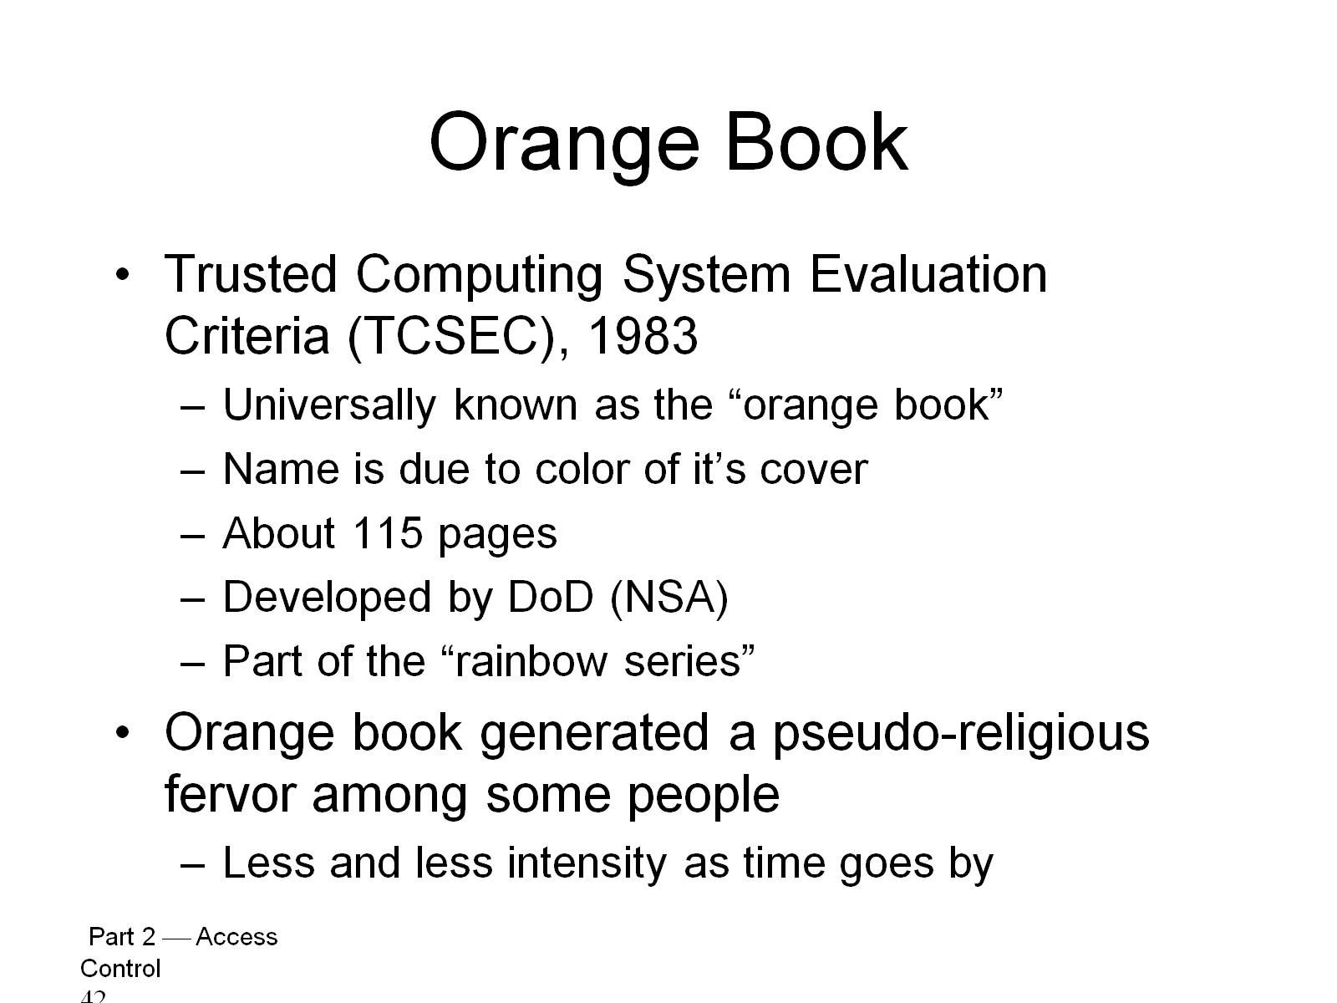
Orange Book

Slide 44
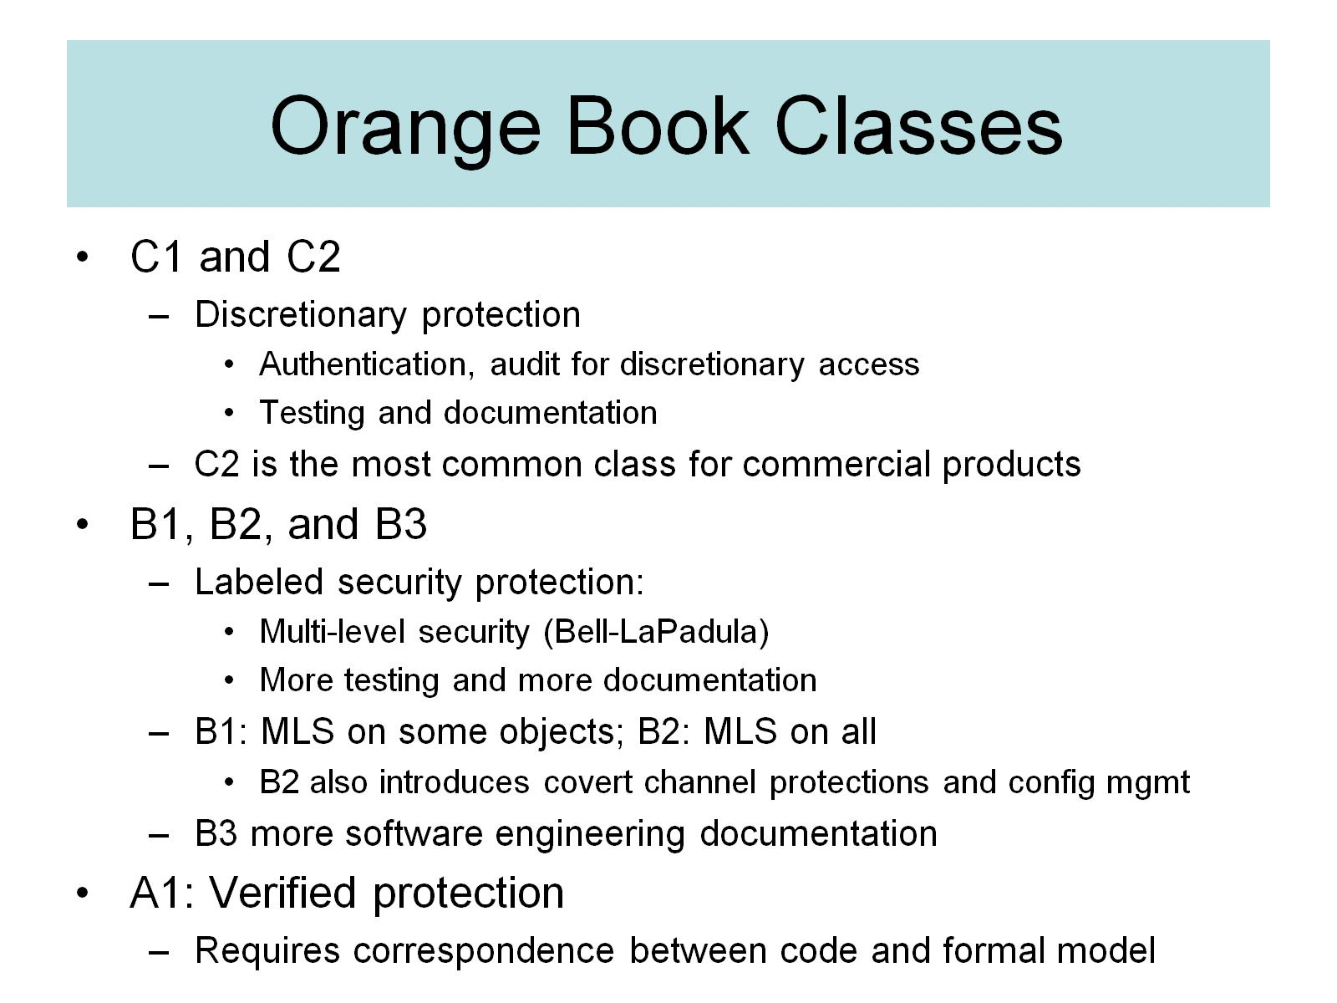
Orange Book Classes

Slide 45
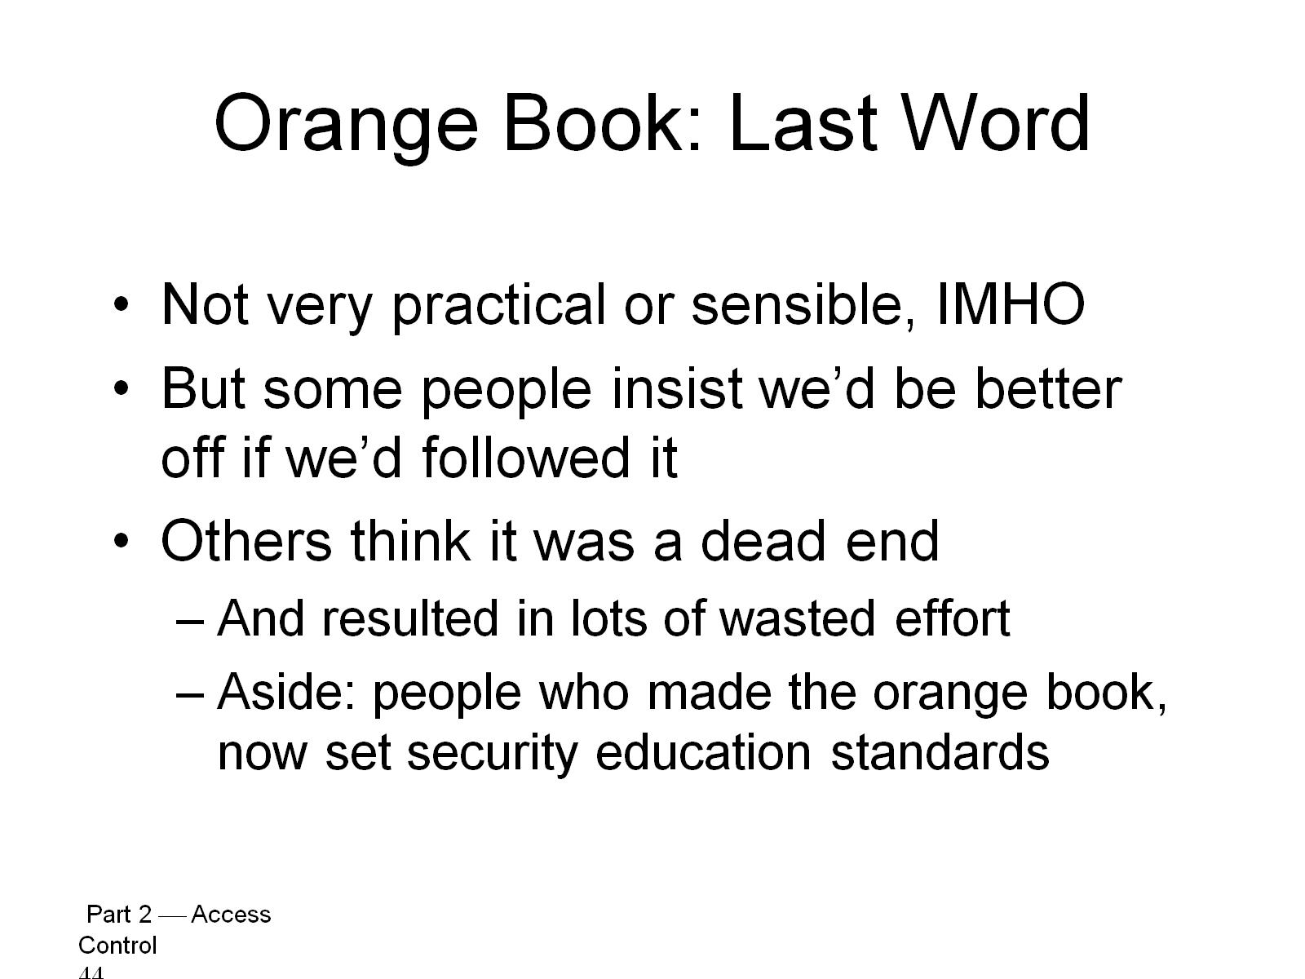
Orange Book: Last Word

Slide 46
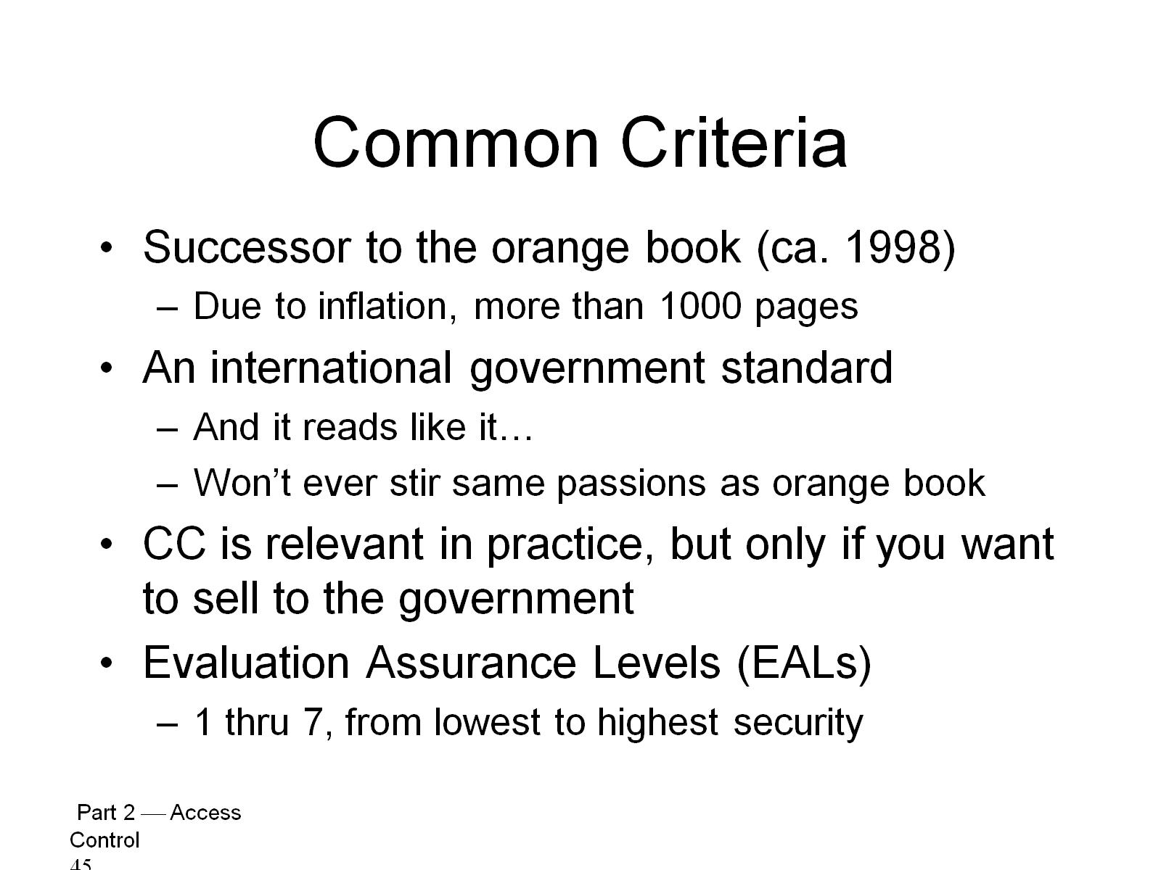
Common Criteria

Slide 47
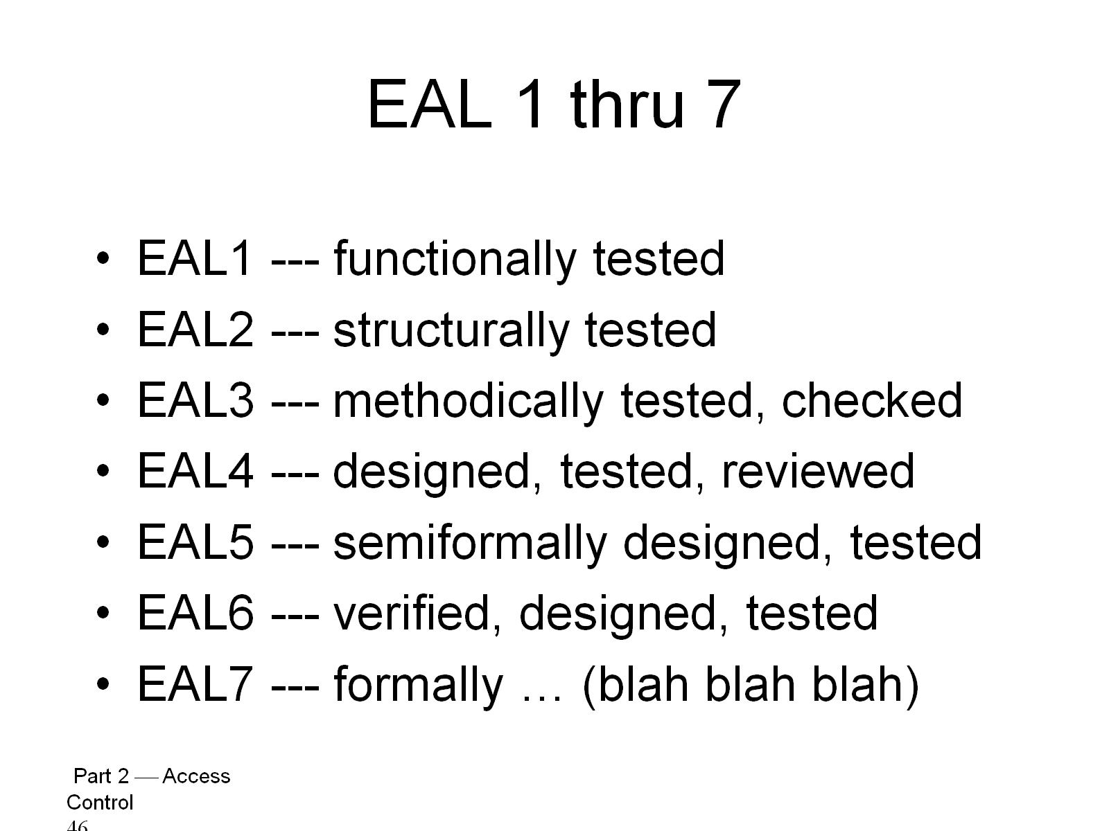
EAL 1 thru 7

Slide 48
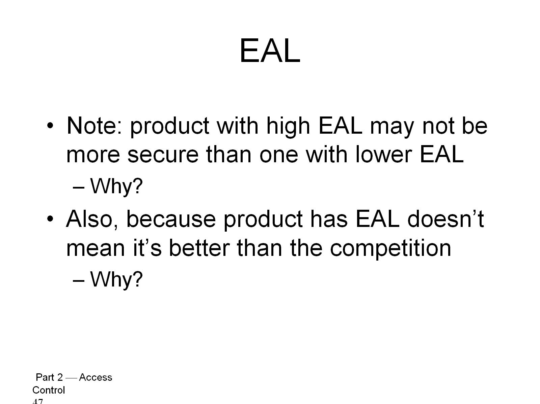
EAL

Slide 49
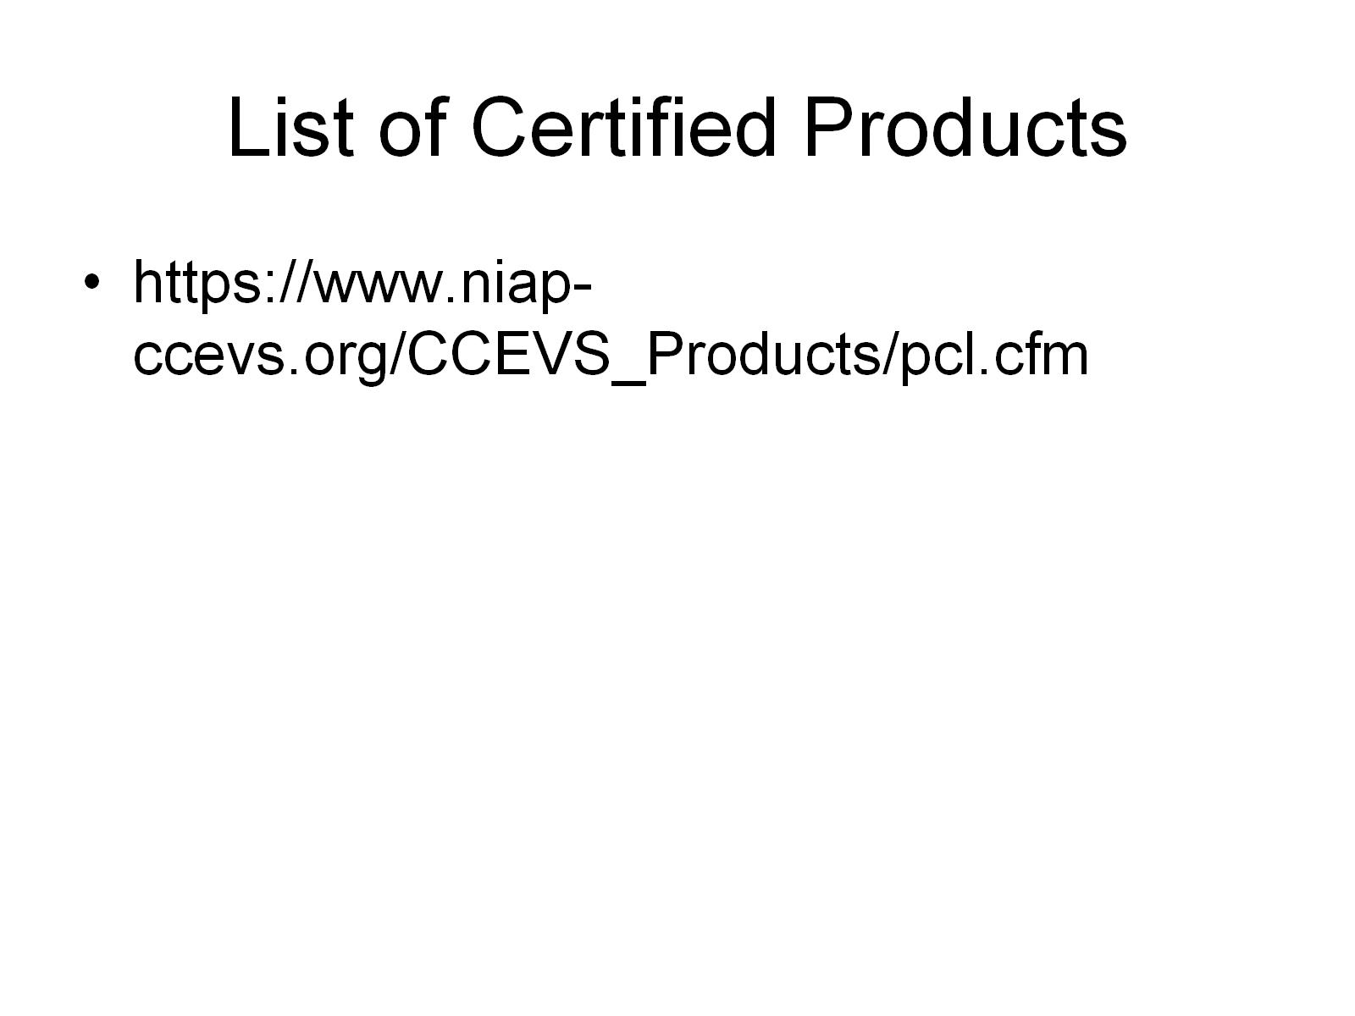
List of Certified Products

Slide 50
Trusted Platform Module (TPM)
concept from Trusted Computing Group
hardware module at heart of hardware / software approach to trusted computing
uses a TPM chip on
motherboard, smart card, processor
working with approved hardware / software
generating and using crypto keys
has 3 basic services: authenticated boot, certification, and encryption
Notes:
The trusted platform module (TPM) is a concept being standardized by an industry consortium, the Trusted Computing Group. The TPM is a hardware module that is at the heart of a hardware/software approach to trusted computing. Indeed, the term trusted computing (TC) is now used in the industry to refer to this type of hardware/software approach.
The TC approach employs a TPM chip in personal computer motherboard or a smart card or integrated into the main processor, together with hardware and software that in some sense has been approved or certified to work with the TPM. We can briefly describe the TC approach as follows. The TPM generates keys that it shares with vulnerable components that pass data around the system, such as storage devices, memory components, and audio/visual hardware. The keys can be used to encrypt the data that flow throughout the machine. The TPM also works with TC-enabled software, including the OS and applications. The software can be assured that the data it receives is trustworthy, and the system can be assured that the software itself is trustworthy. To achieve these features, TC provides three basic services authenticated boot, certification, and encryption.

Slide 51
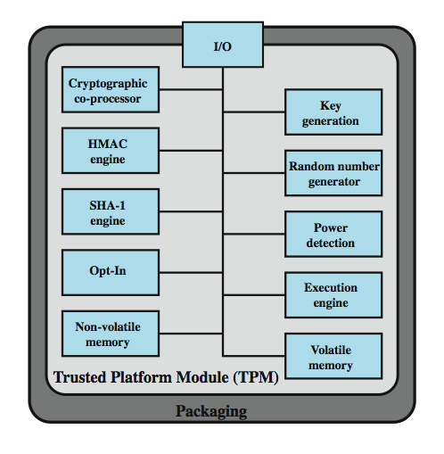
TPM Functions
Notes:
Figure 10.12, based on the most recent TPM specification, is a block diagram of the functional components of the TPM. These are:
• I/O: all commands enter and exit through the I/O comms to other TPM components.
• Cryptographic co-processor: specialized for RSA encryption & related processing.
• Key generation: Creates RSA public/private key pairs and symmetric keys.
• HMAC engine: This algorithm is used in various authentication protocols.
• Random number generator (RNG): produces random numbers for key generation, random values in digital signatures, and nonces.
• SHA-1 engine: implements SHA for digital signatures and HMAC algorithm
• Power detection: manages TPM power states with platform power states
• Opt-In: to securely allow TPM to be enabled or disabled at customer/user's discretion.
• Execution engine: runs TPM commands program code.
• Non-volatile memory: to store persistent identity and state parameters for this TPM.
• Volatile memory: for temporary storage for execution functions, plus storage of volatile parameters: current TPM state, cryptographic keys, session information.

